Slide 1
Background
Hurricane models are sensitive to representation of surface fluxes
Basic Meteorological Direct fluxes:
  Sensible Heat, H_{s}
  Latent Heat, H_{l}
  Momentum, τ
  Kinetic Energy=-τ*U(z)
Fluxes on Ocean Side
  Momentum and Energy (waves and currents)
  Thermodynamic
At High Winds Sea Spray Becomes Relevant
  How Much Sea Spray? Source function, S_{n}(r)
  What does S_{n} do?
    Direct Heat Q_{s}
    Evaporation Heat Q_{l}
    Effect on momentum flux through buoyancy

Slide 2
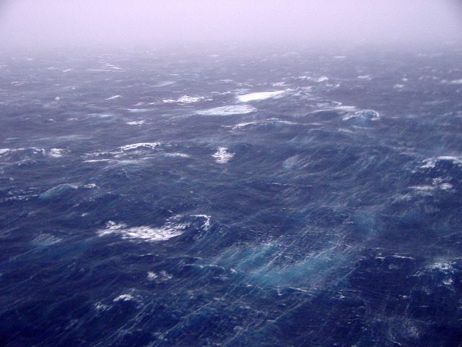
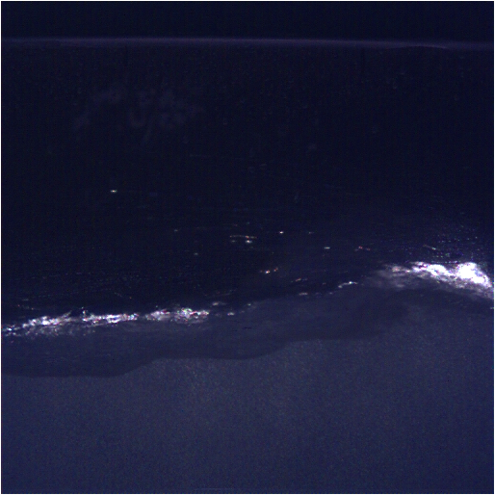
Definition of Droplet Source Flux At Sea-air Interface
Number(r)/m²/sec
HOWEVER:
At least one additional piece of information is required to characterize the source.
*Initial ejection velocity W_{ej}
*Effective height h

Slide 3
Droplet Source Functions
Fairall et al. 1994
Fairall-Banner Physical Model:
Balance of energy produced by wave breaking and lost in production of drops and bubbles. Error function describes probability drop trajectory escapes surface.
P energy wave breaking
σ surface tension
r droplet radius
η Kolmogorov microscale in the ocean
f fraction of P going into droplet production
U_{top} wind speed near breaker top
U_{b} group speed of breaking wave
Λ Unspecified length scale (or, P/ Λ volume dissipation near surface)

Slide 4
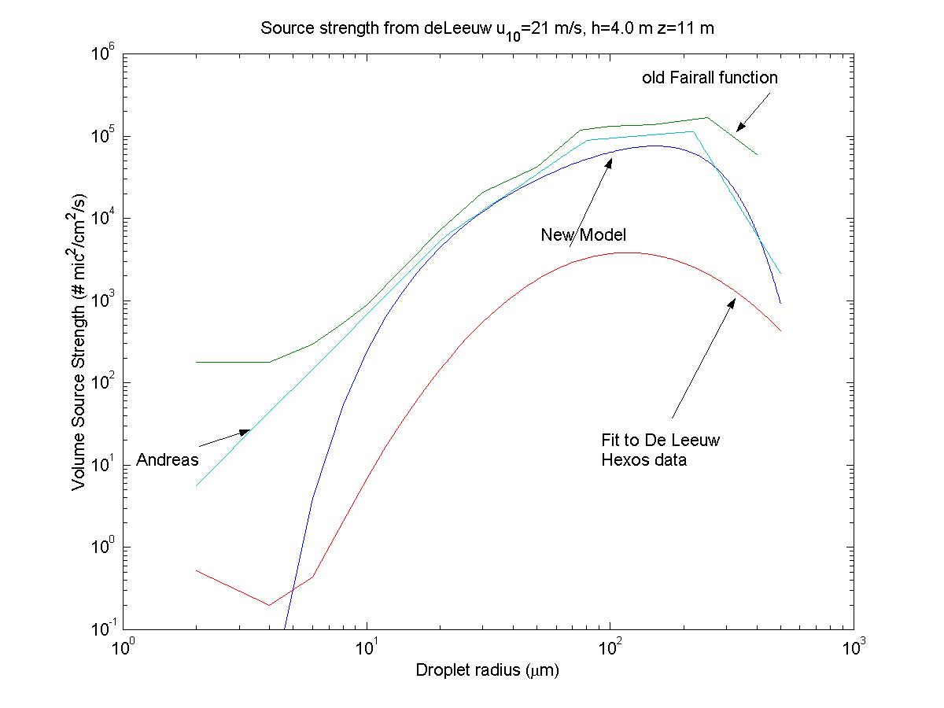
S_{n} Surface Source Strength for Sea Spray Droplets

Slide 5
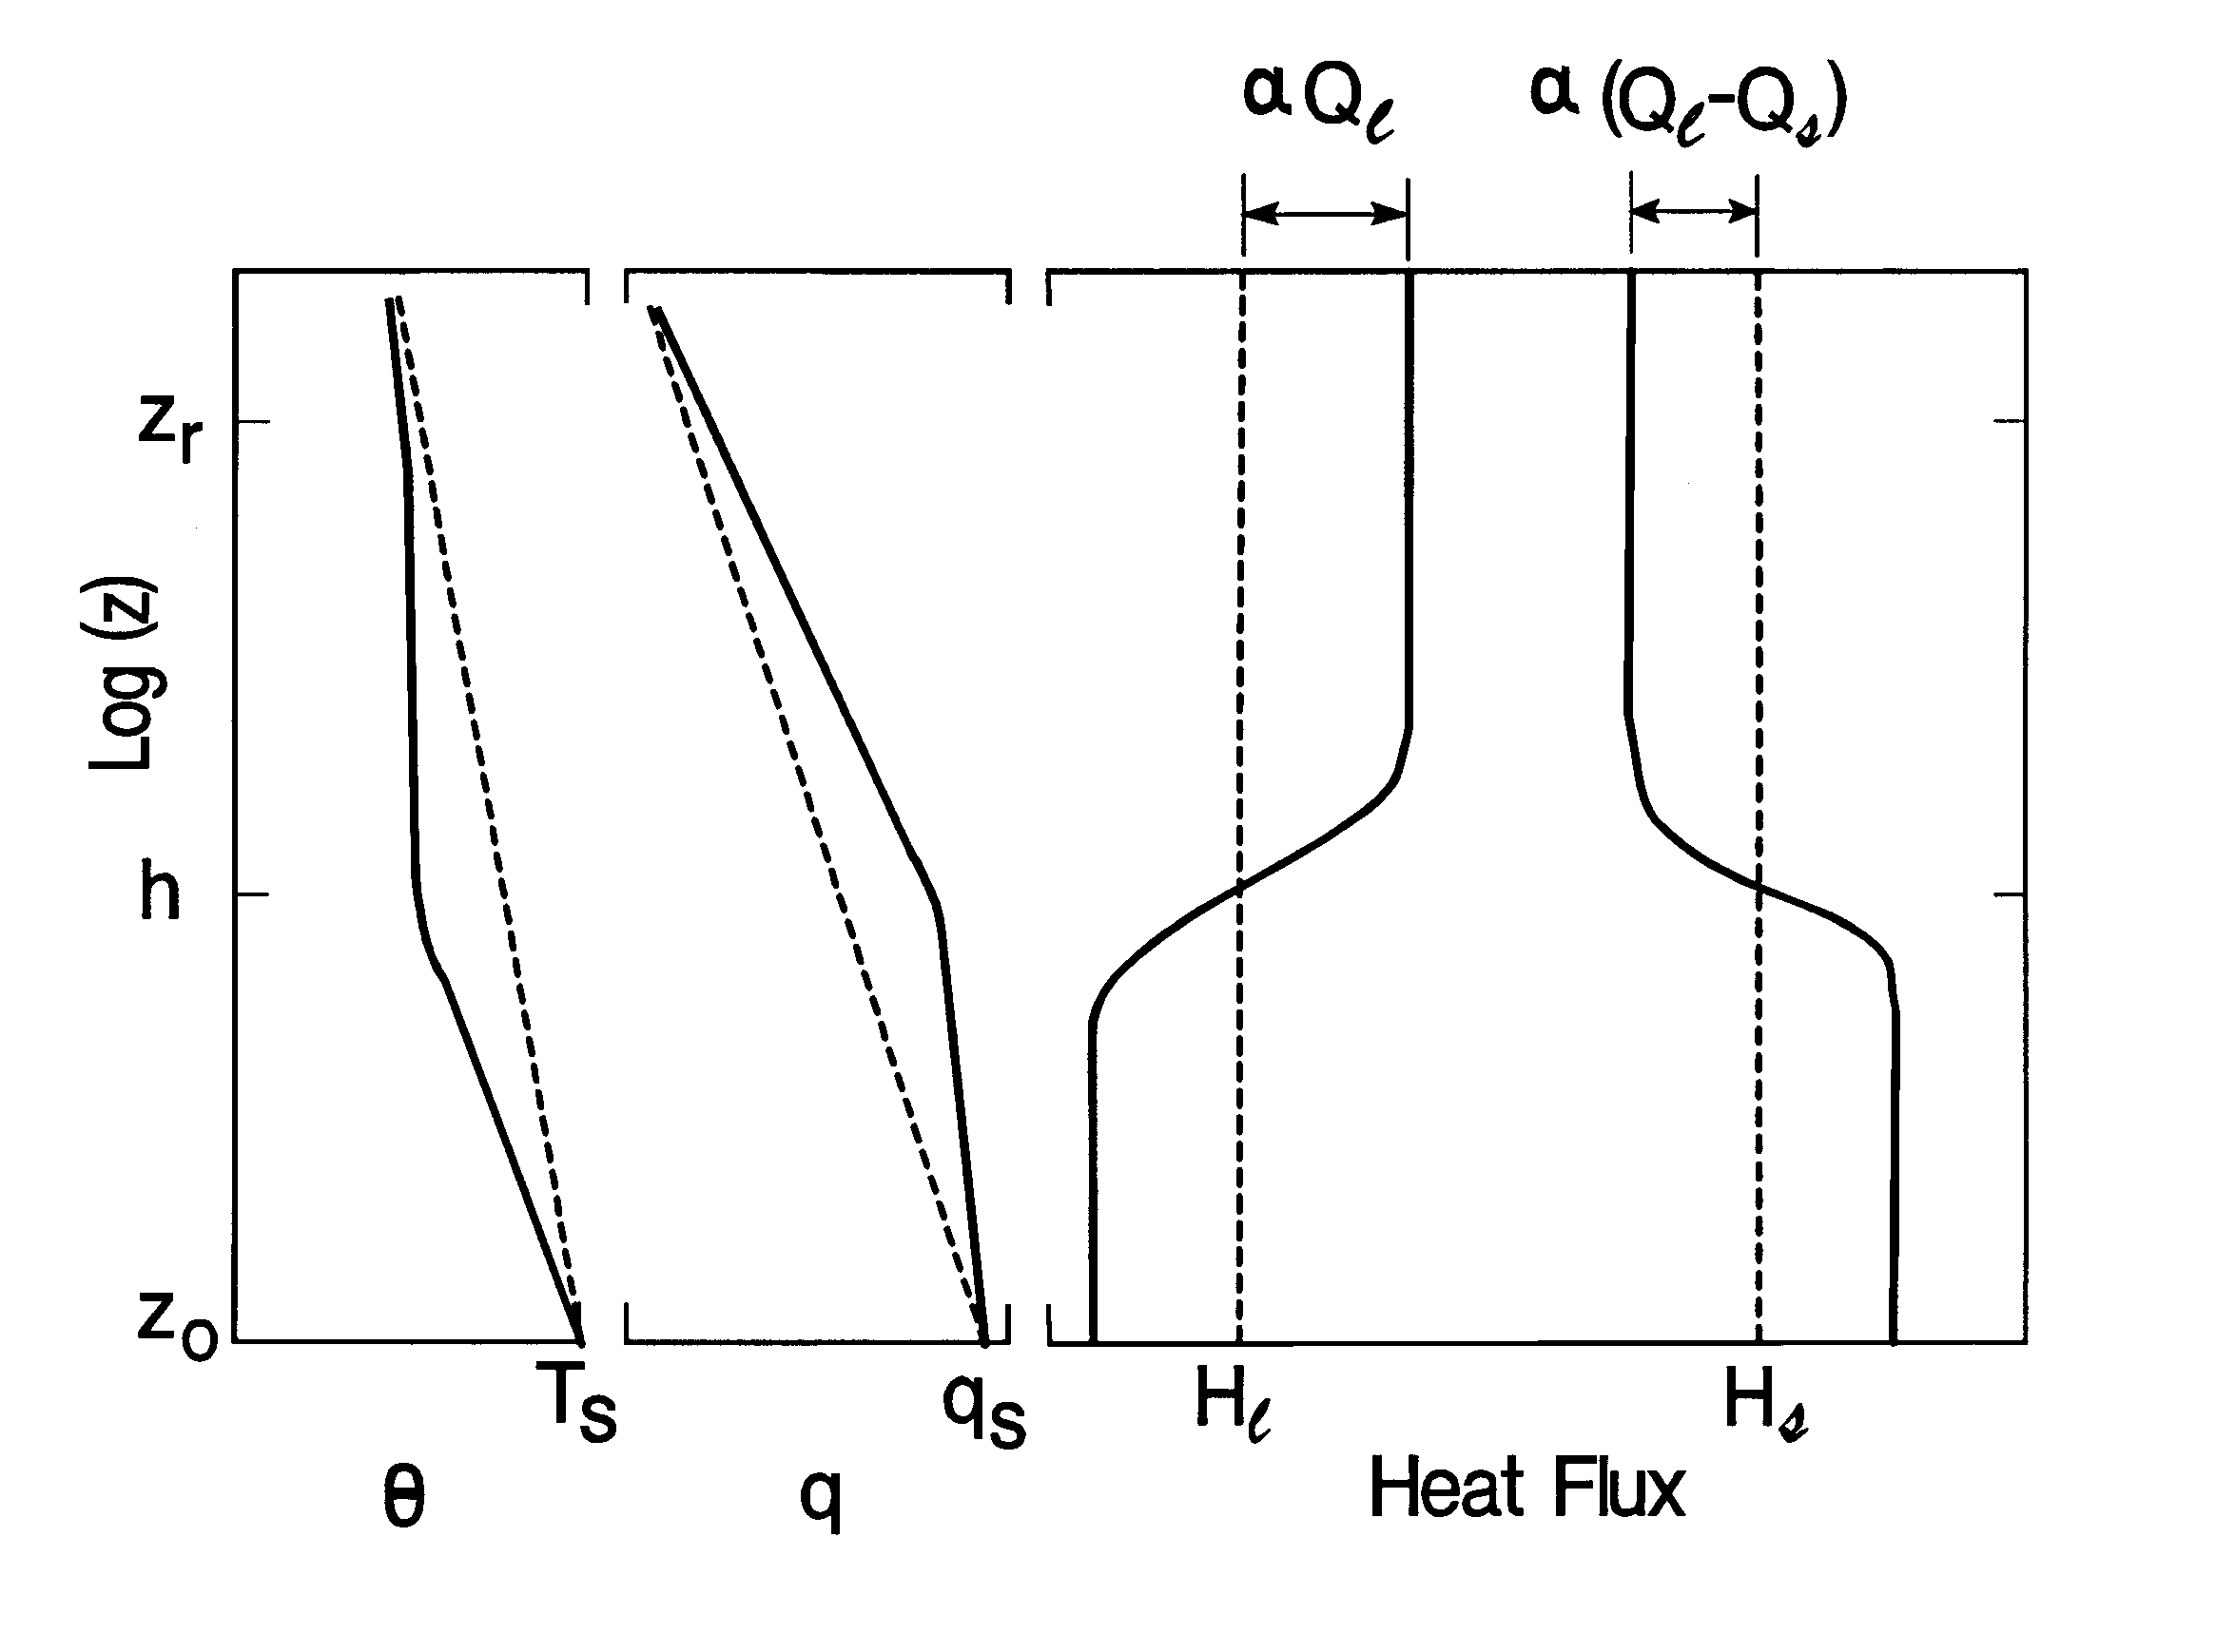
Feedback
Defined by distortions of the temperature & humidity profiles in the Droplet evaporation zone: δT δq
Net fluxes emerging from top of droplet layer
Alpha accounts for feedback (droplet – T/q profile interactions)

Slide 6
Parameterization of the Sea-Spray Modification of
Heat Fluxes (Fairall et al. 1994; Bao and Fairall et al. 2008)
turbulence fluxes
spray mediated
fluxes
where δT_{a} is based on the sea-spray enthalpy balance (Andreas and Emanuel 2001)
where the factor of 25 is an adjustment to approximately agree with the previous version of the scheme

Slide 7
Parameterization of the Sea-Spray Modification of
Momentum Flux (e.g., Barenblatt 1996 and Lykossov 2001)
where S is the spray mass concentration profile.
turbulent suspension vs freefall
where
the mean fall speed of droplets
empirical parameter
spray generation height

Slide 8
Ck/Cd ratio

Slide 9
Wave-Spray-Flux Coupling
Compute ‘corrections’ to existing model u*, Hs, Hl
Wave model takes inputs produces spray mass flux, plus other quantities to yield new u*, DHs, DHl
Simple approach: Input wind speed and use parameterized wave properties – NRL COAMPS TC
Coupled approach: Input wave properties from wave model – GFDL (used GFDL because coupled HWRF not ready yet)
Wave properties – Energy breaking, Cp, Hsig

Slide 10
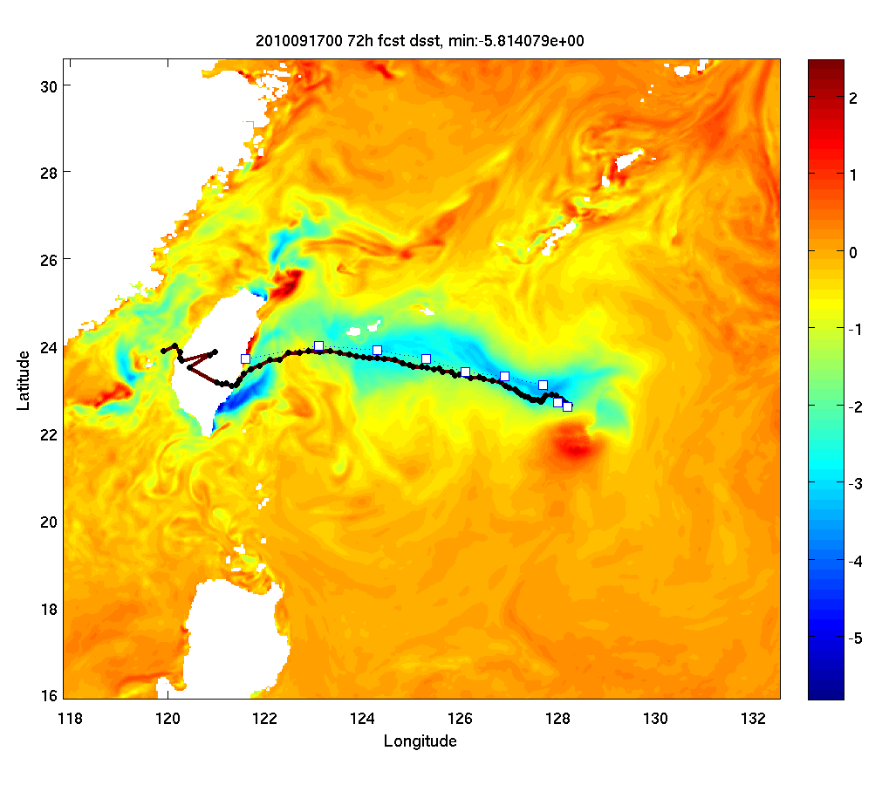
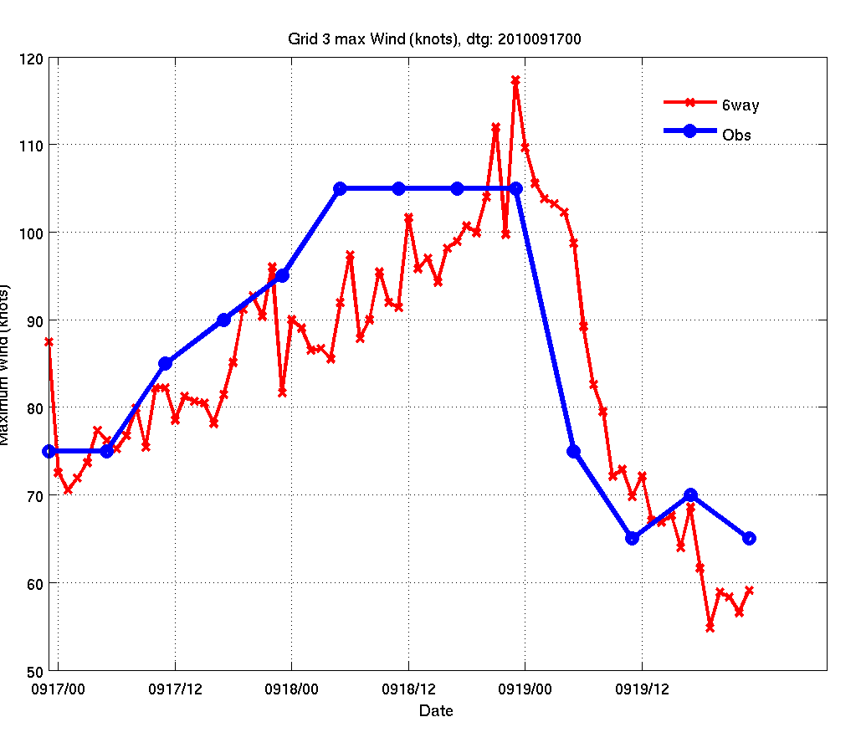
High-Resolution Coupled COAMPS Simulations of Fanapi
72 h SST anomaly
Atmosphere: 27, 9, and 3 km
Ocean: 9 and 3 km
Wave: 1/6 degree
Model spin-up from 2010090800
12 h update cycle
3-4 °C cold wake
Intensity overall is good

Slide 11
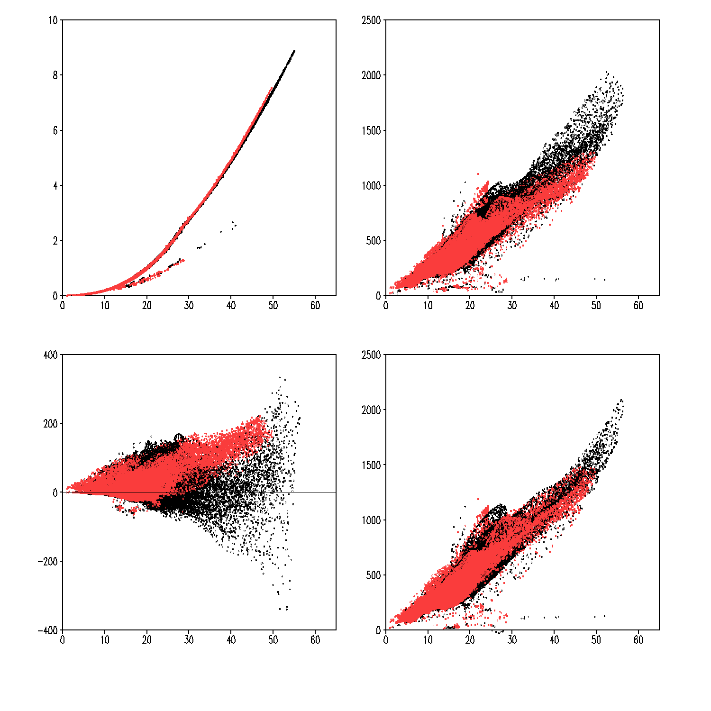
Impacts of Sea Spray on Turbulent Fluxes in Uncoupled COAMPS-TC (Melor 2009)
Latent heat flux (W m⁻²)
Sensible heat flux (W m⁻²)
Enthalpy flux (W m⁻²)
No Spray
Spray
Wind speed (m/s)
Wind speed (m/s)
Wind speed (m/s)
Sea spray (older version) increases latent heat flux due to the enhanced evaporation.
The negative heat flux stabilizes the boundary layer.
Enthalpy flux increases moderately.

Slide 12
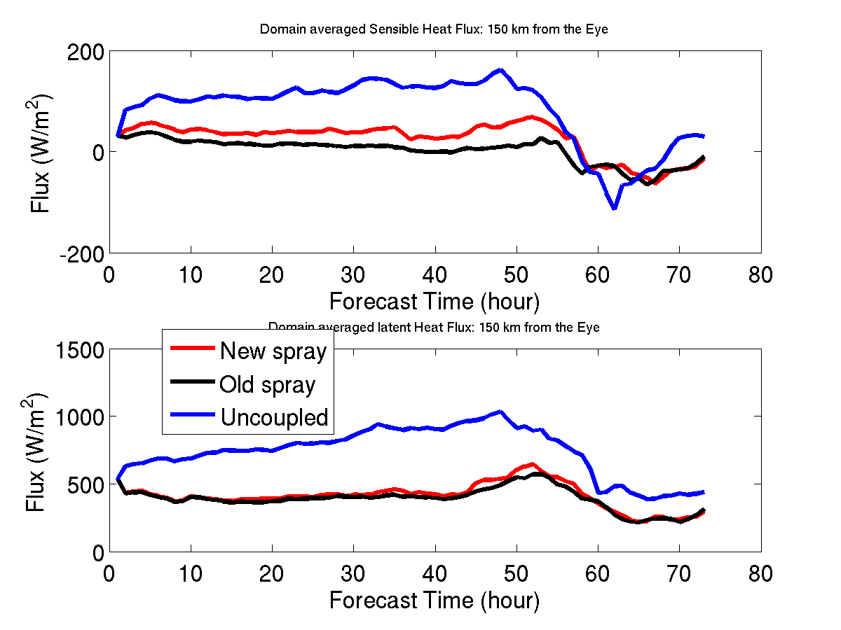
Effect of Sea Spray on Fanapi Simulations
Averaged fluxes within 150 km radius of eye
New sea spray increases more sensible flux
Smaller increase in latent heat flux
Fully coupled run has a 32% less total flux over the ocean compared to the uncoupled run
New sea spray provides about 5% flux increase
With new sea spray, there is still a large flux difference between coupled and uncoupled runs
Sensible
Latent

Slide 13
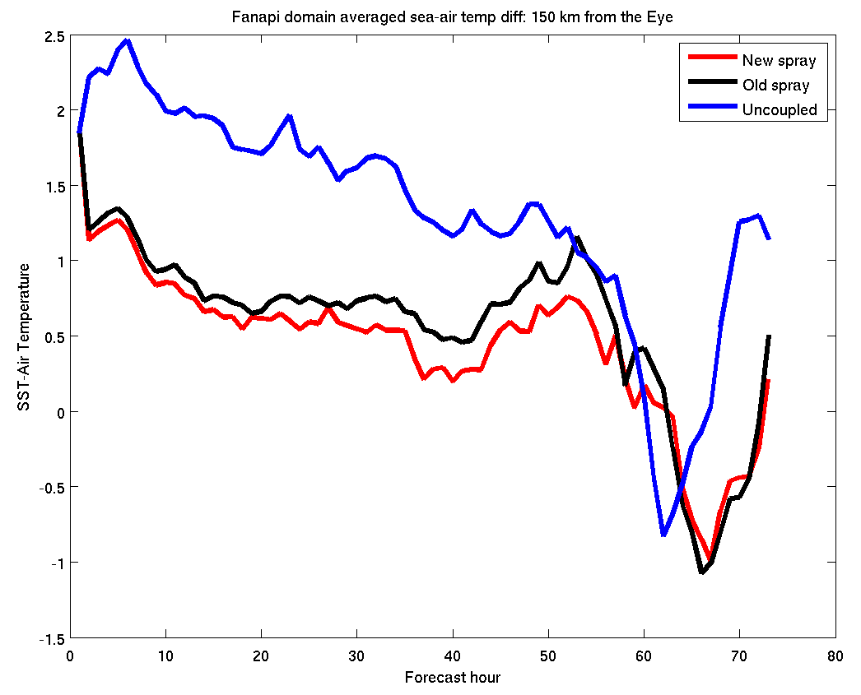
Effect of Sea Spray on Fanapi Simulations
Averaged air-sea temperature difference
fully coupled (new spray): 0.45°C
fully coupled (old spray): 0.58°C
Uncoupled: 1.33°C
Air-sea temperature difference

Slide 14
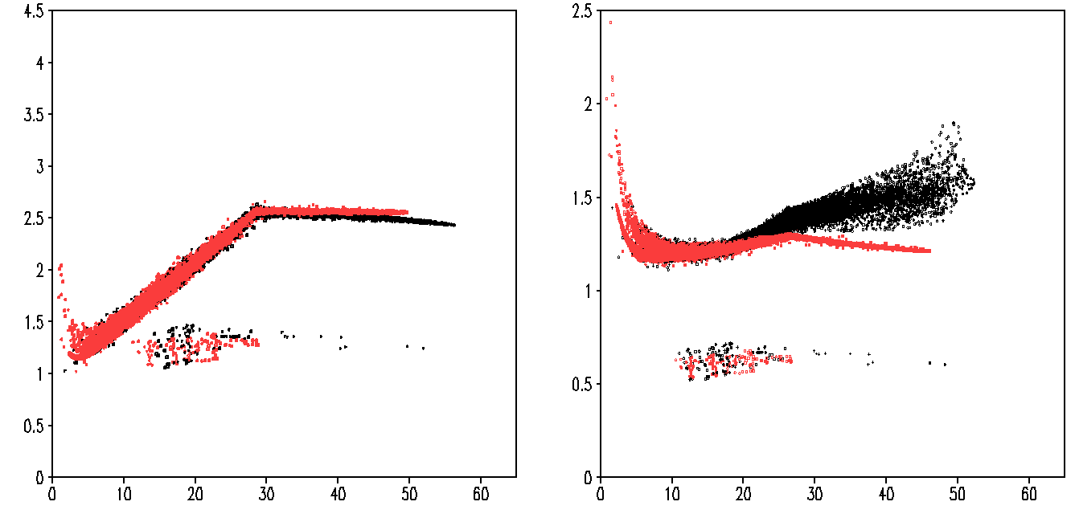
Transfer Coefficients
Uncoupled COAMPS-TC
C_{d}
No Spray
C_{e}
Spray
CBLAST
COAMPS-TC (Melor 2009)
Wind speed (m/s)
Wind speed (m/s)
Sea spray representation (version 9, Fairall and Bao)
C_{d} slightly decreases when the sea spray effect is enhanced.
C_{e} increases for wind speed greater than 30 m/s.

Slide 15
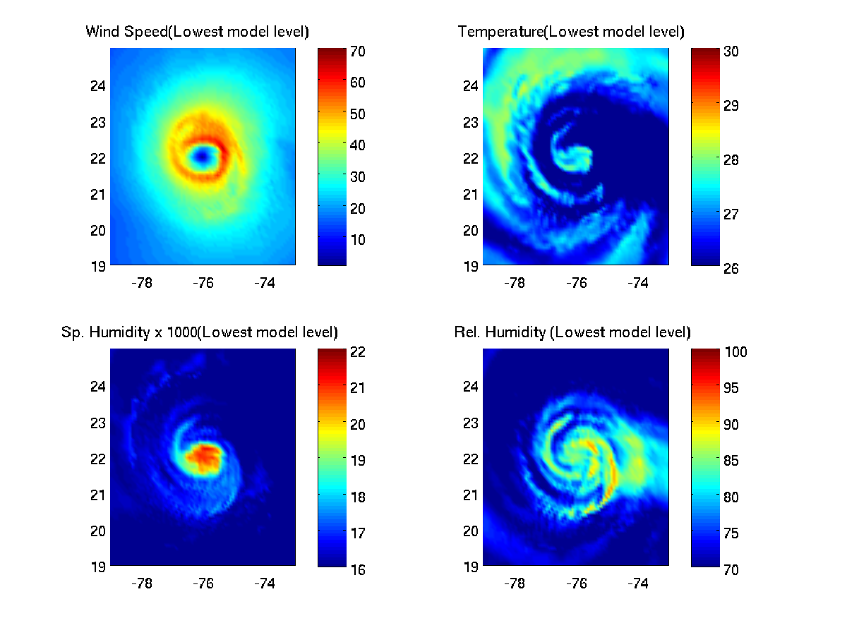
GFDL Hurricane Katia

Slide 16
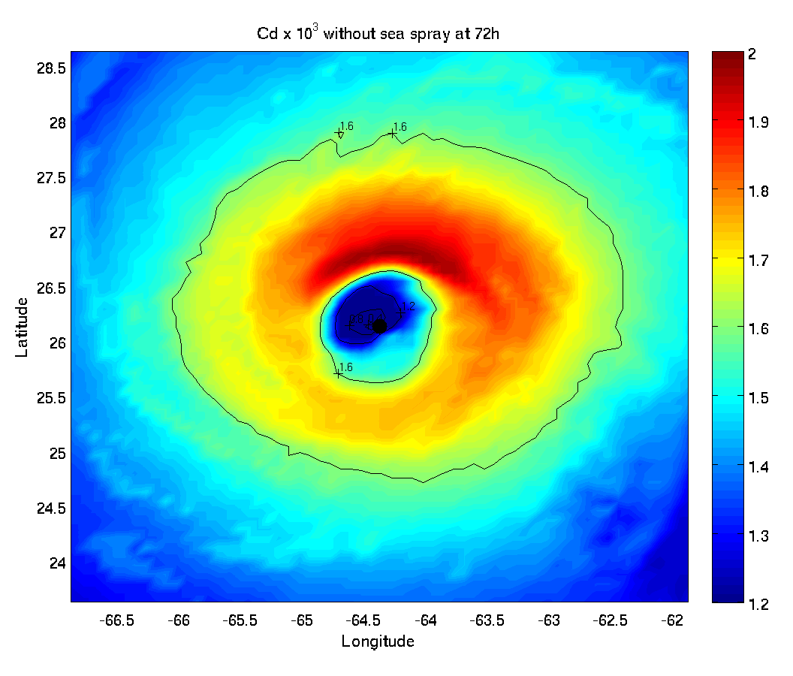
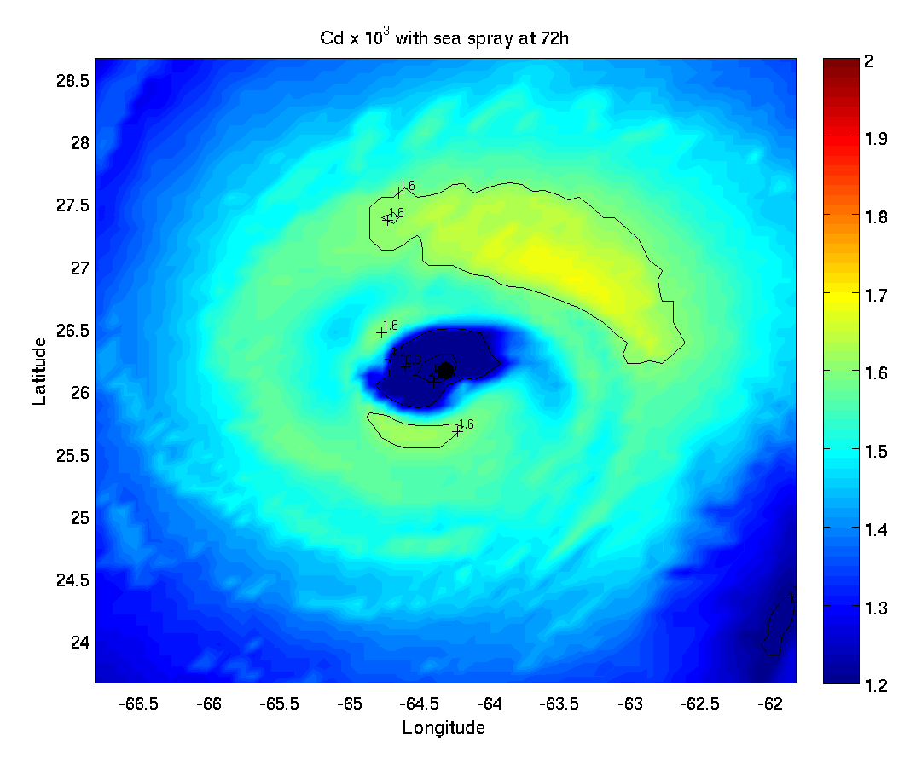
Spray version 9+

Slide 17
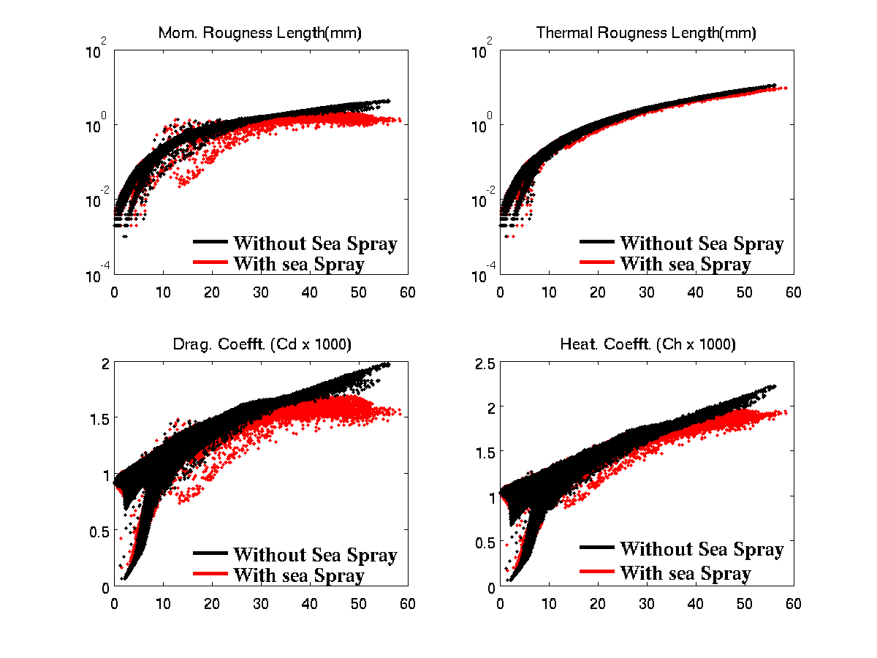

Slide 18
