Slide 1
Data Assimilation and Predictability Studies for Improving Tropical Cyclone Intensity Forecasts
March 2012, NOPP TC Topic Review, Miami
PI: Takemasa Miyoshi
University of Maryland, College Park
miyoshi@atmos.umd.edu
Co-PIs: E. Kalnay, K. Ide (UMD), and C. H. Bishop (NRL)
Co-Is: T. Enomoto, N. Komori (Japan), S.-C. Yang (Taiwan), H. Li (China)
Collaborators: T. Nakazawa (WMO), P. Black (NRL)
Project Researcher: M. Kunii (UMD)

Slide 2
Project Overview
DA Method
LETKF
Local Ensemble Transform Kalman Filter (Hunt et al. 2007)
Adaptive inflation/localization
Ensemble sensitivity methods
Running-In-Place/Quasi-Outer-Loop
Better use of observations
Large-scale environment
CFES-LETKF using the Earth Simulator
Air-Sea-Coupled data assimilation
Mesoscale
WRF-LETKF
Cloud-resolving data assimilation

Slide 3
Achievements in a nutshell
 | Year 1 | Year 2
DA method | Adaptive Inflation (1 paper) Impact of resolution degradation (1 paper) | Running-In-Place (1 paper submitted) Observation error correlations (1 paper)
CFES-LETKF | AFES-LETKF experiments | CFES-LETKF development and experiments
WRF-LETKF | WRF-LETKF system development (1 paper) Observation impact study of the Sinlaku case using the ensemble method (1 paper) | Including SST uncertainties in EnKF (1 paper submitted) AIRS data assimilation (1 paper submitted) Direct use of the best-track data Further observation impact study with multiple cases of T-PARC and ITOP2010 Development of the 2-way-nested heterogeneous LETKF
Deliverables | 4 peer-reviewed papers 13 conference presentations (2 invited) | 4 peer-reviewed papers (3 under review) 8 conference presentations (2 invited)

Slide 4
Running-in-place (RIP)
Studies on methods: towards optimal use of available observations
Yang, Kalnay, and Hunt (2012, in press)
Yang, Miyoshi and Kalnay (2012, submitted)
Yang, Lin, Miyoshi, and Kalnay (in progress)

Slide 5
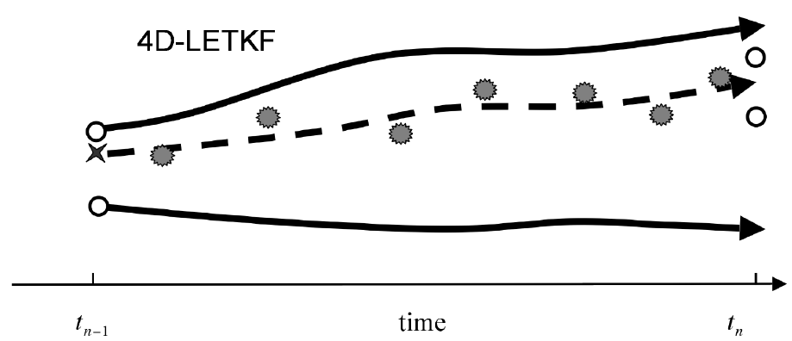
Running-In-Place (RIP, Kalnay and Yang 2008)
4D-LETKF: Ensemble Kalman Smoother
○
○
○
★
○
t_{n-1}
t_{n}
Running-In-Place (RIP) method:
Update the state (★) at t_{n-1} using observations up to t_{n} (smoother)
Assimilate the same observations again (dealing with nonlinearity)
Repeat as long as we can extract information from the same obs.

Slide 6
In OSSE, RIP is very promising
This is a simulation study.
Realistic observing systems are assumed, including dropsondes near the TC.
Vortex strength and structure are clearly improved.
Yang, Miyoshi and Kalnay (2012)

Slide 7
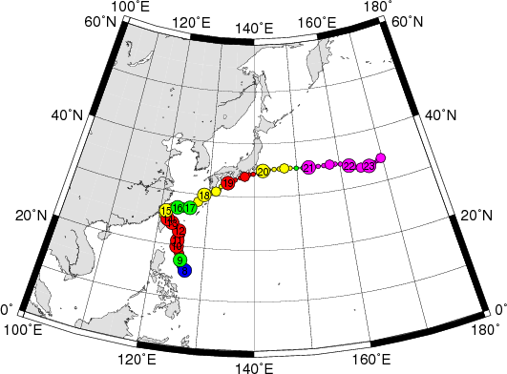
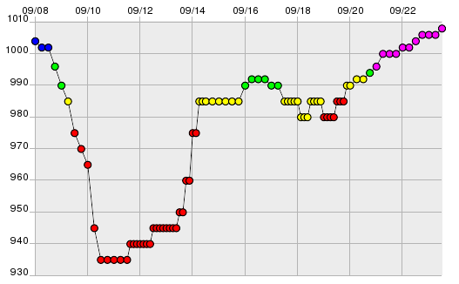
Typhoon Sinlaku (2008)
Track
MSLP

Slide 8
RIP impact on Sinlaku track forecast
This is the real case.
S.-C. Yang (2012)

Slide 9
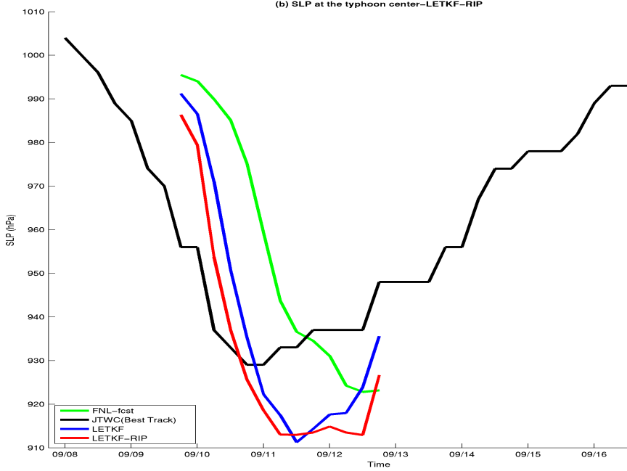
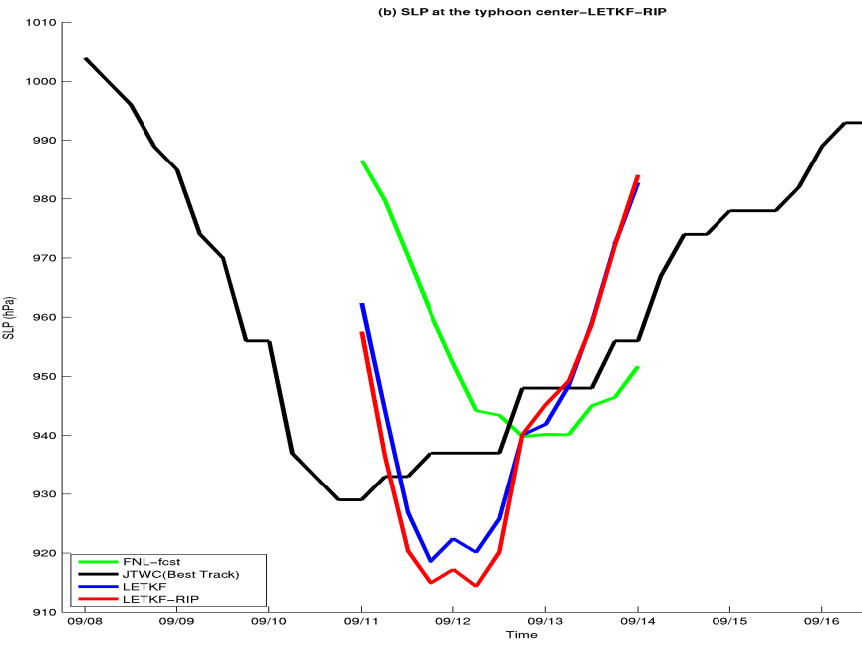
RIP impact on Sinlaku intensity forecast
This is the real case.
09/09 18Z (poor obs coverage)
09/11 00Z(good obs coverage)
The LETKF-RIP helps the intensification of the typhoon during the developing stage. But the typhoon intensity is over predict during the mature stage.
Yang and Lin (2012)

Slide 10
CFES-LETKF development
CFES-LETKF: global air-sea-coupled data assimilation
Komori, Enomoto, and Miyoshi (in progress)

Slide 11
Air-Sea-Coupled DA
Surface Temperature
Ensemble Spread
Atmos. ONLY
Air-Sea-Coupled

Slide 12
Air-Sea-Coupled DA
Latent Heat Flux
Ensemble Spread
Sinlaku
Atmos. ONLY
Air-Sea-Coupled

Slide 13
Ensemble spread is increased!
SPRD(Air-Sea-Coupled) – SPRD(Atmos. ONLY)
Temperature
Specific Humidity
Particularly in the Tropics at the low levels
We are investigating the impact on TC forecasting!

Slide 14
Sst uncertainties
WRF-LETKF: including additional sources of uncertainties
Kunii and Miyoshi (2011, under review)

Slide 15
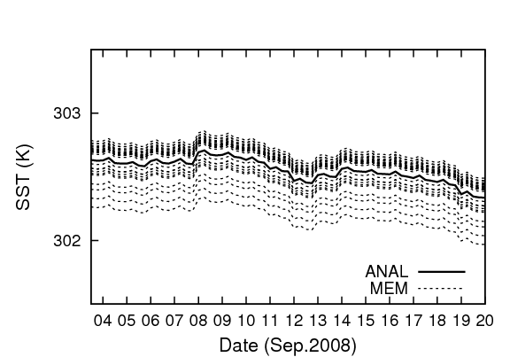
Impact of SST ens. perturbations
1. SST is randomly perturbed
around the SST analysis
in the WRF-LETKF cycle.
The SST perturbations are
the differences between SST
analyses on randomly chosen dates.
2. Deterministic forecast
is improved in general.
(NO SST perturbations
in the forecast, i.e., the
difference is purely due
to the I.C.)
6-h fcst fit to raob
averaged over 4 days

Slide 16
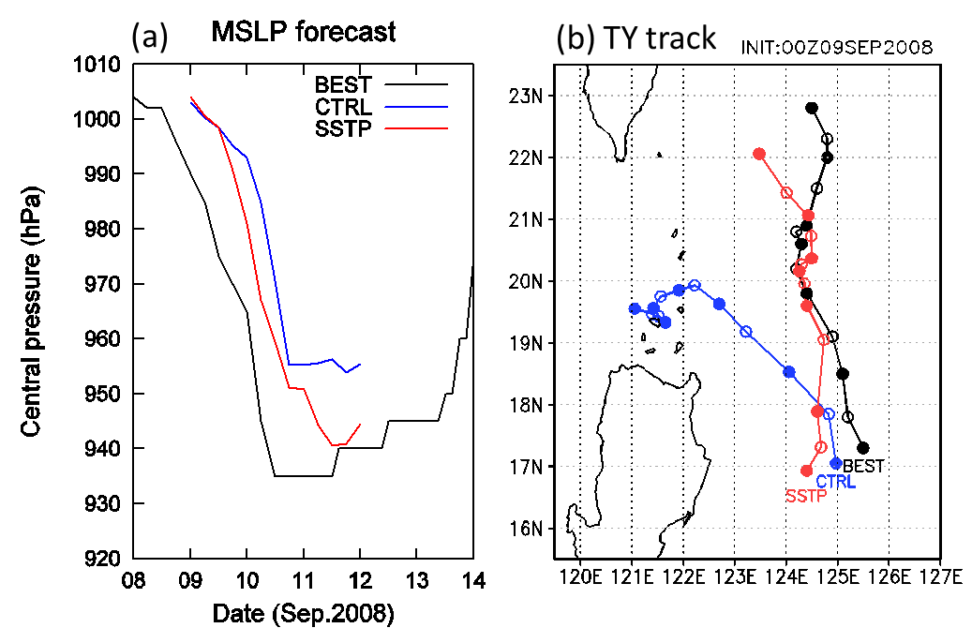
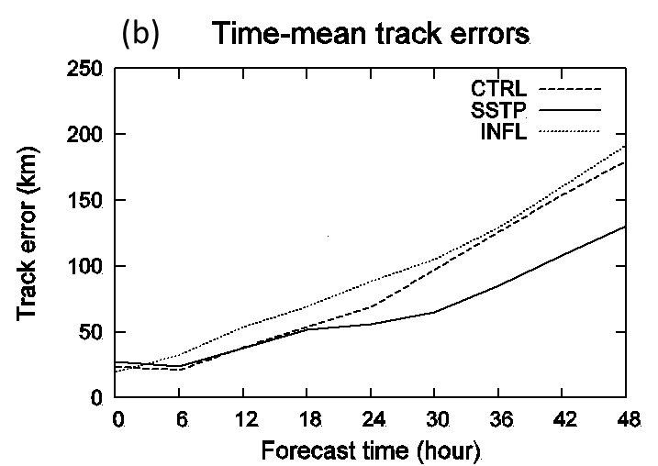
Improvement in TC forecasts
3. TC intensity and
track forecasts are
greatly improved.
(NO SST perturbations
in the forecast)
4. Improvement is not only
in the single case.
(NO SST perturbations
in the forecast)

Slide 17
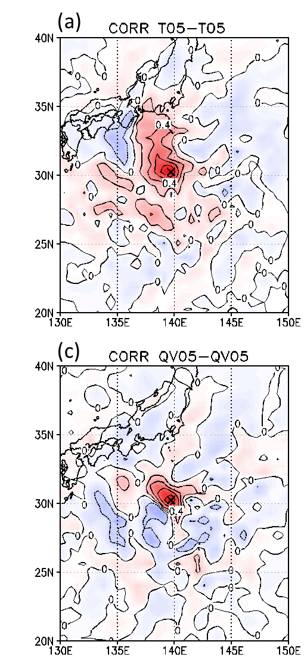
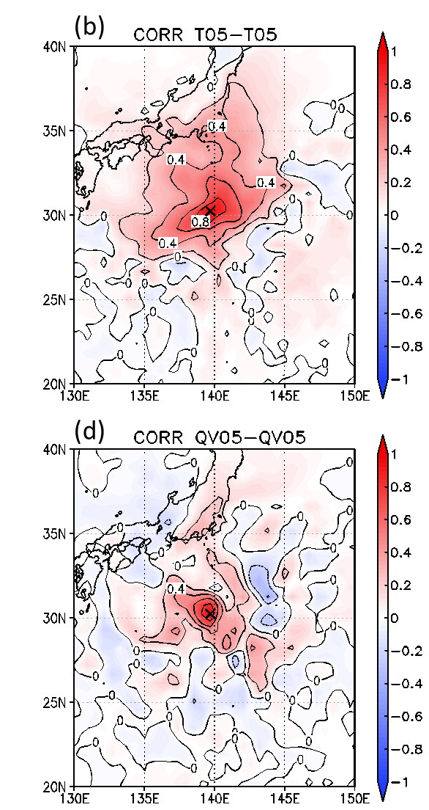
Error covariance structure
Unperturbed SST
Perturbed SST
T
T
Generally broader error covariance structure with perturbed SST
Q
Q

Slide 18
ASSIMILATION OF Airs data
WRF-LETKF: using satellite data
Miyoshi and Kunii (2011, under review)

Slide 19
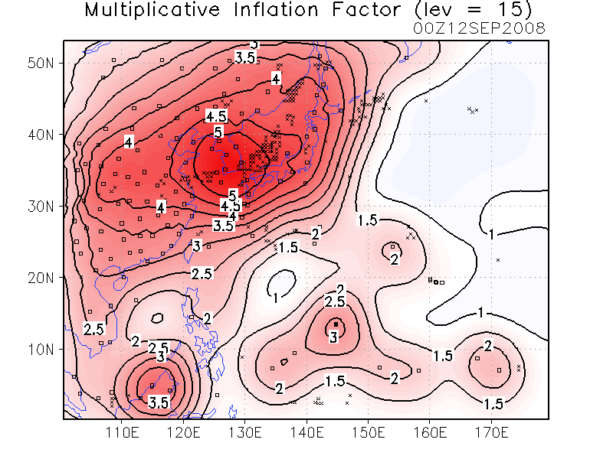
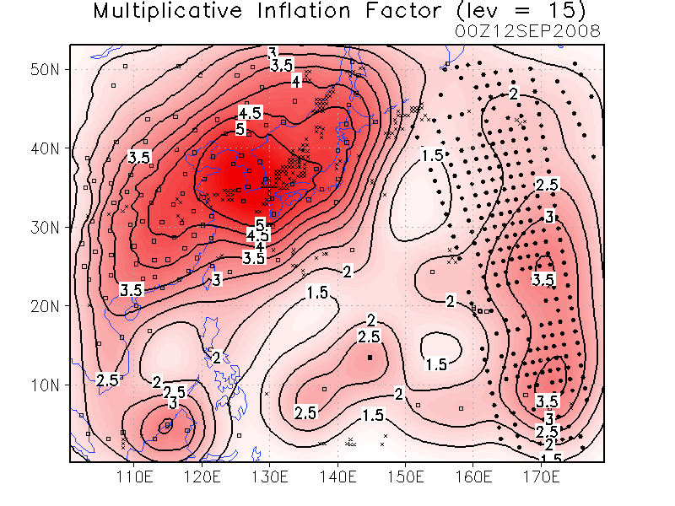
Assimilation of AIRS retrievals
CTRL | AIRS
Conventional (NCEP PREPBUFR) | Conv. + AIRS retrievals (AIRX2RET - T, q)
Larger inflation is estimated due to the AIRS data.
August-September 2008, focusing on Typhoon Sinlaku

Slide 20
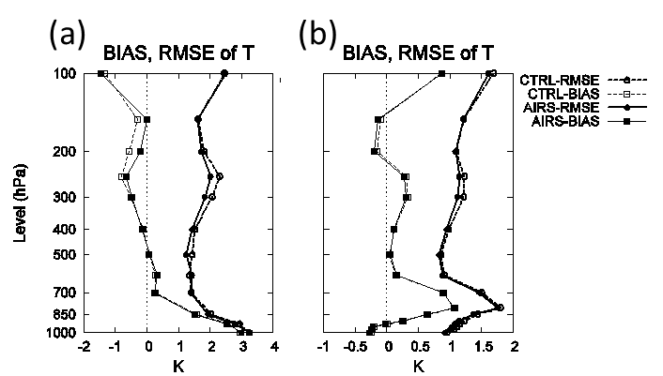
72-h forecast fit shows general improvements
Relative to radiosondes
Relative to NCEP FNL
1-week average over September 8-14, 2008

Slide 21
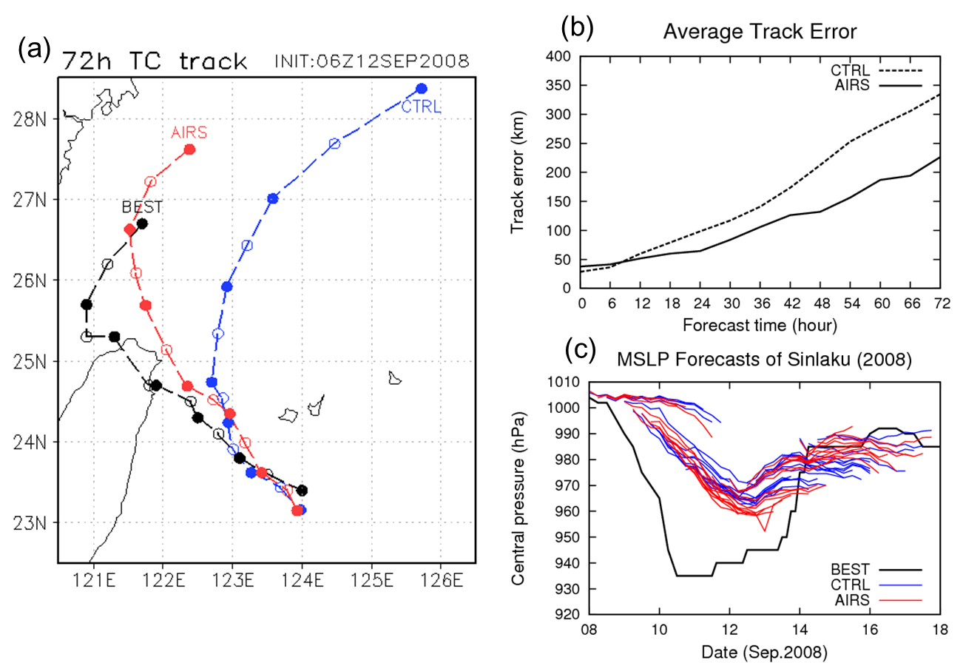
AIRS impact on TC forecasts
~28 samples
Too deep to resolve by 60-km WRF
TC track forecasts for Typhoon Sinlaku (2008) were significantly better, particularly in longer leads.

Slide 22
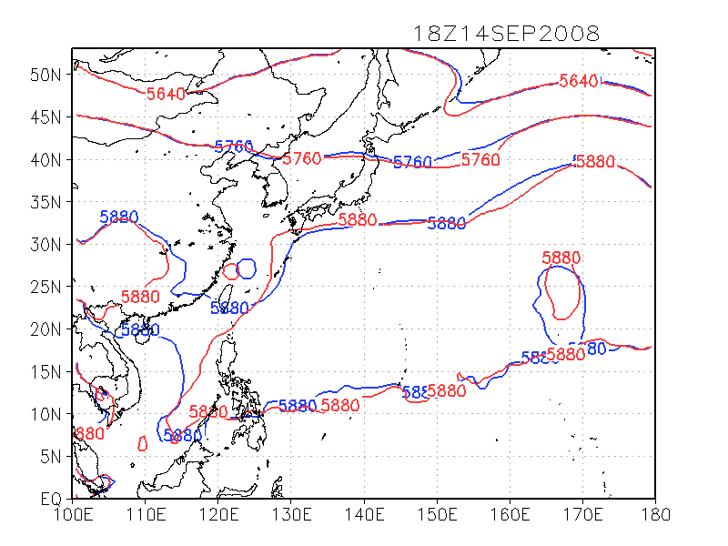
Subtropical High
60-h forecast 500 hPa geopotential height shows difference in the NW edge of Sub-high.
AIRS
CTRL

Slide 23
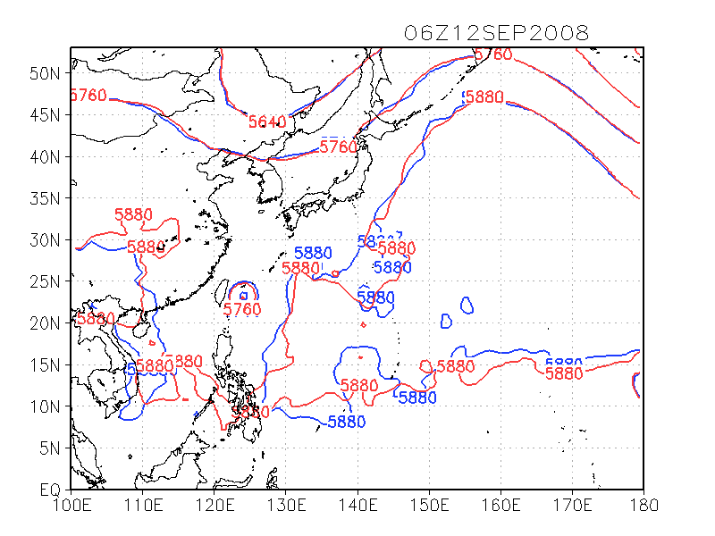
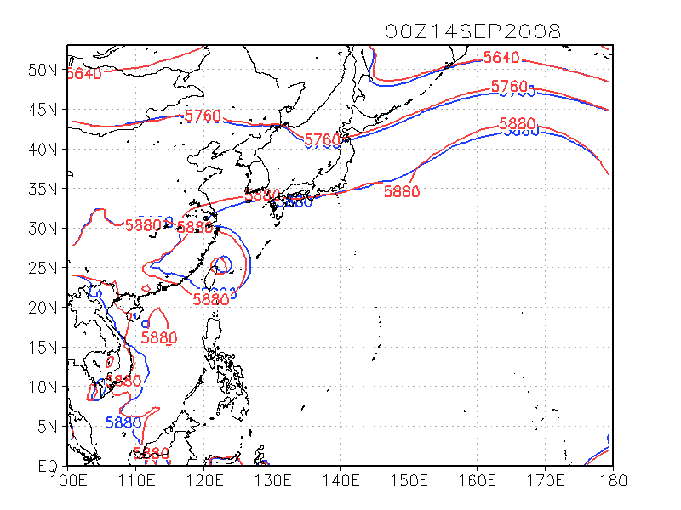
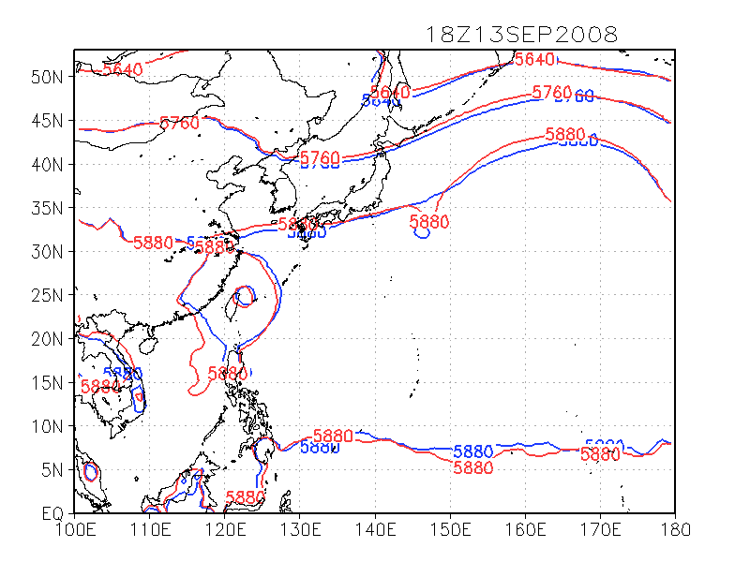
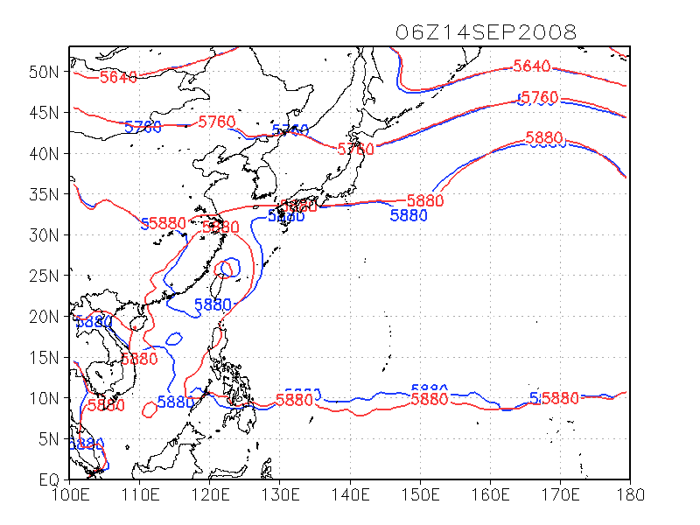
Subtropical High forecasts
INIT
42-h
AIRS
CTRL
36-h
48-h
Similar sub-high
Different!!

Slide 24
Ensemble-based obs impact
WRF-LETKF: towards optimizing observing systems
Kunii, Miyoshi and Kalnay (2011, Mon. Wea. Rev.)
Kunii, Miyoshi, Kalnay and Black (in progress)

Slide 25
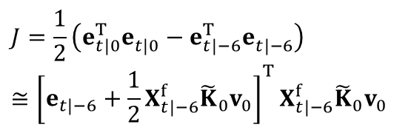
Forecast sensitivity to observations
Observation impact is calculated without an adjoint model. (Liu and Kalnay 2008, Li et al. 2009)
We applied the above method to real observations for the first time! (Kunii, Miyoshi, and Kalnay 2011)
This difference comes from obs at 00hr
$$J=\frac{1}{2}\left(e_{t|0}^{T}e_{t|0}^{}−e_{t|−6}^{T}e_{t|−6}^{}\right)$$
$$≅{\left[e_{t|−6}+\frac{1}{2}X_{t|−6}^{f}{\tilde{K}}_{0}v_{0}\right]}^{T}X_{t|−6}^{f}{\tilde{K}}_{0}v_{0}$$

Slide 26
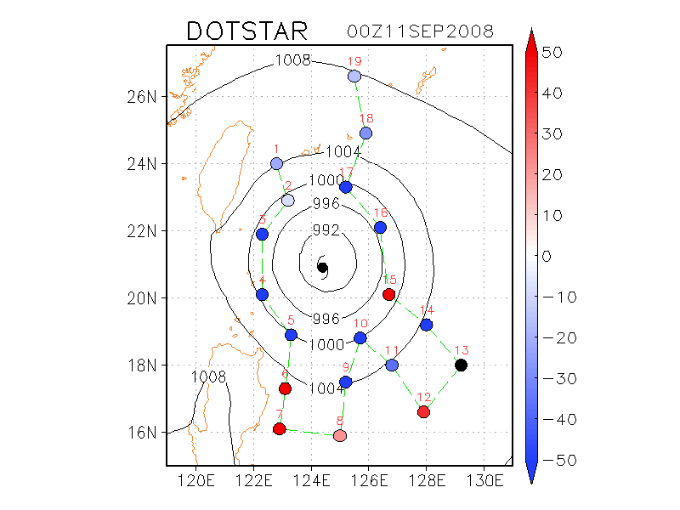
Impact of dropsondes on a Typhoon
Estimated observation impact
Degrading
TY Sinlaku
Improving

Slide 27
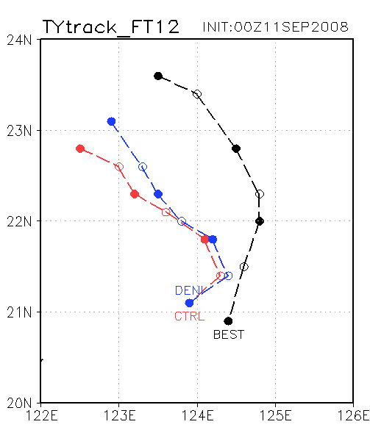
Denying negative impact data improves forecast!
Estimated observation impact
Typhoon track forecast is actually improved!!
Improved forecast
36-h forecasts
Observedtrack
TY Sinlaku
Original forecast

Slide 28
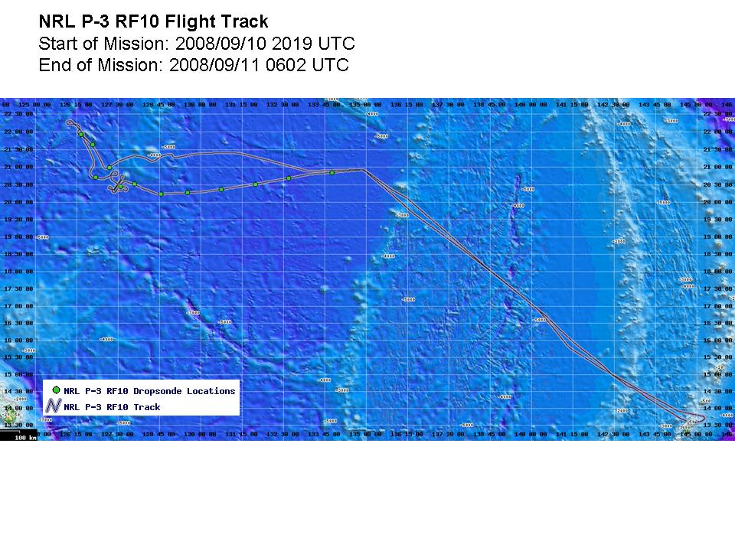
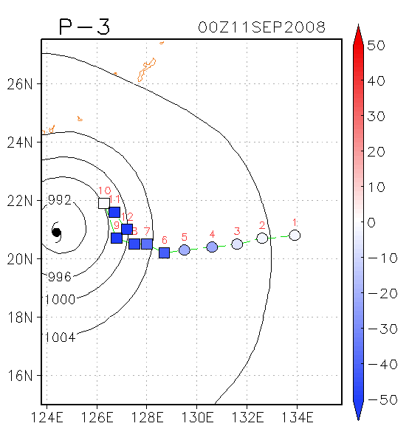
Impact of NRL P-3 dropsondes

Slide 29
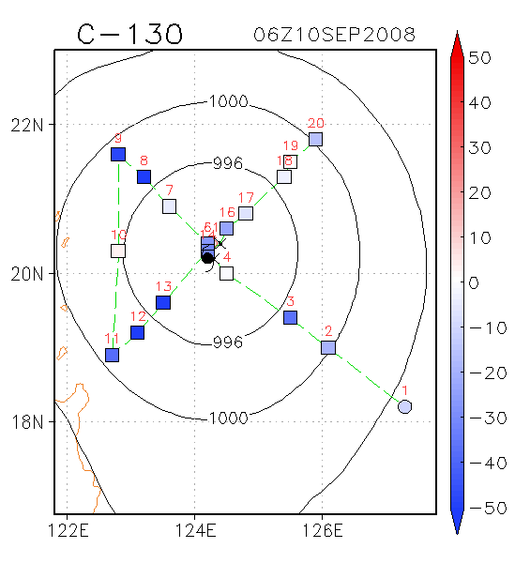
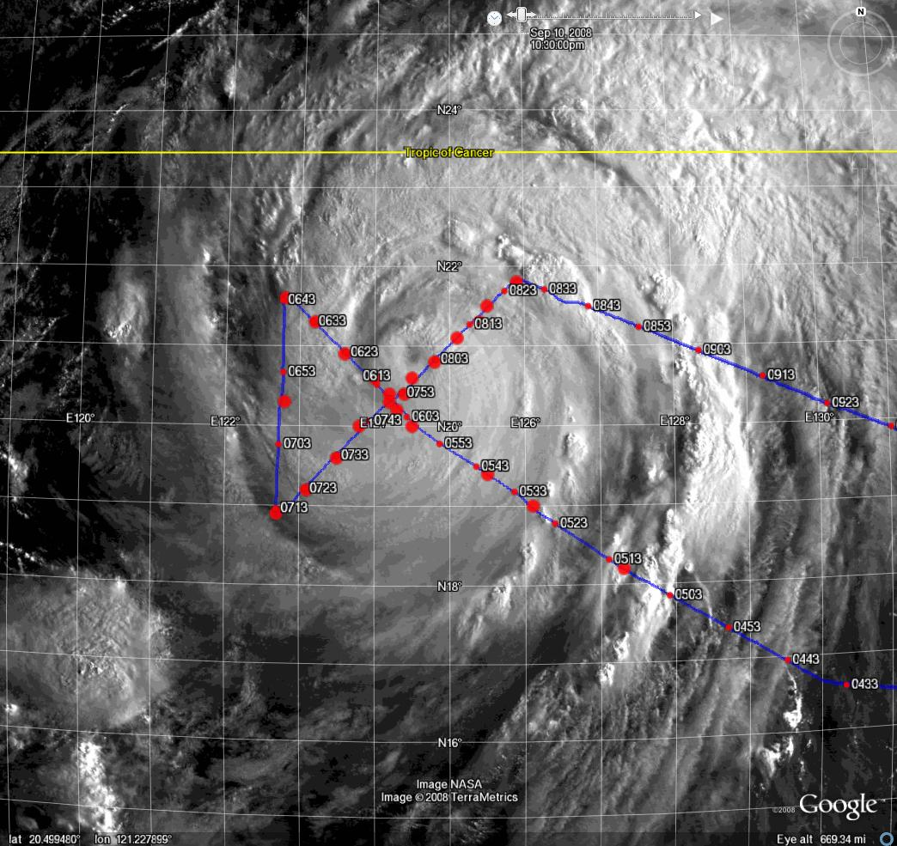
Impact of WC-130J dropsondes

Slide 30
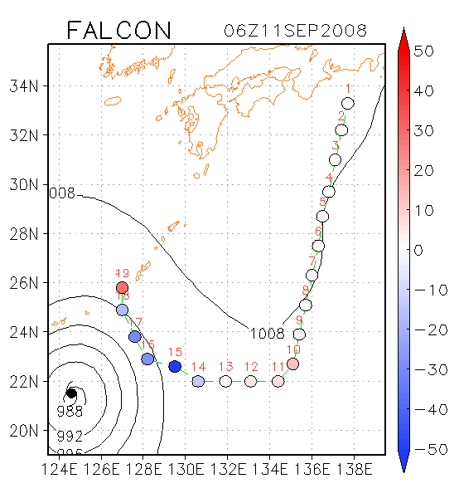
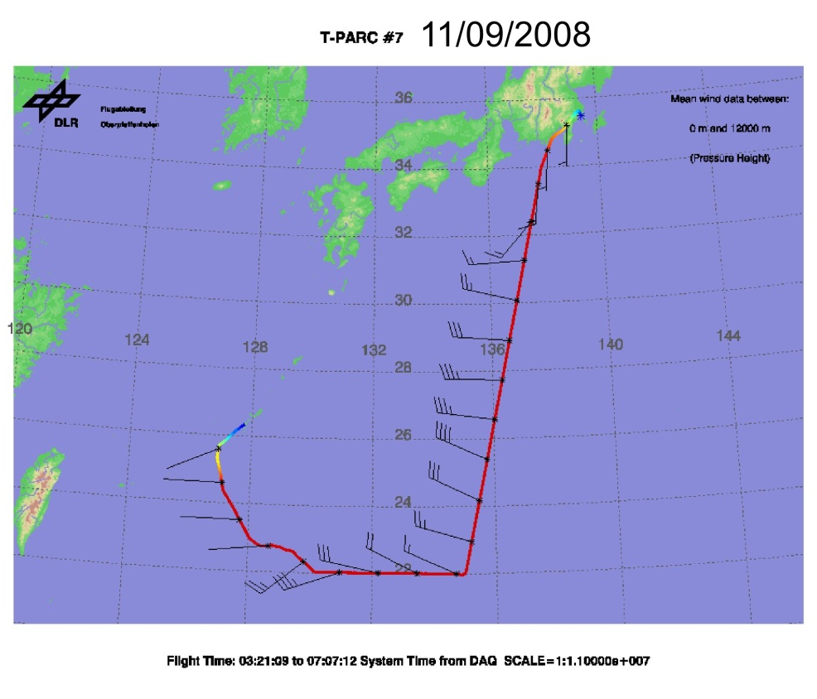
Impact of DLR Falcon dropsondes

Slide 31
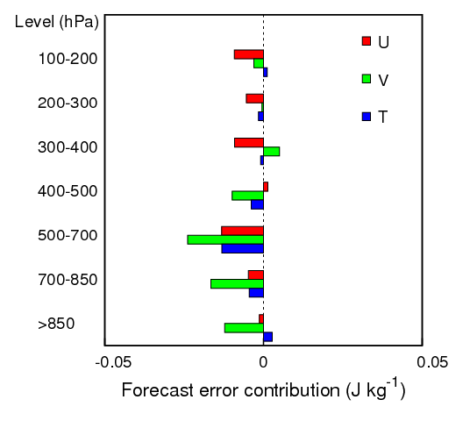
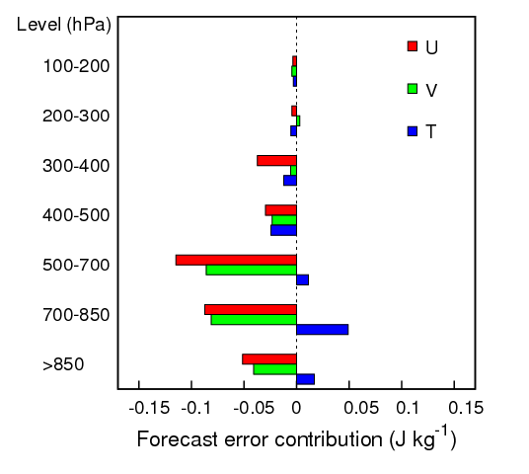
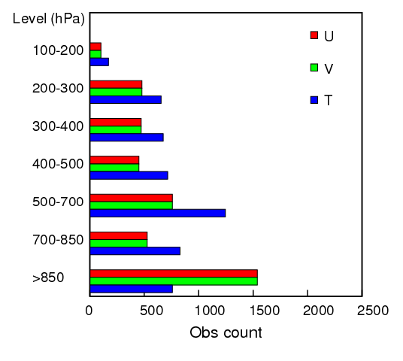
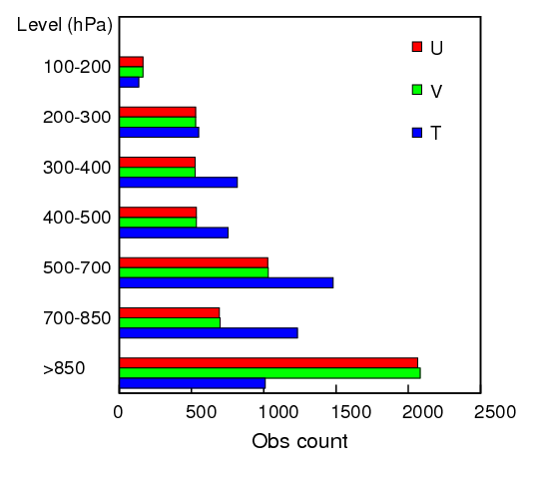
Overall impacts of dropsondes (T-PARC/ITOP2010)
T-PARC 2008
ITOP 2010
improving
degrading
improving
degrading

Slide 32
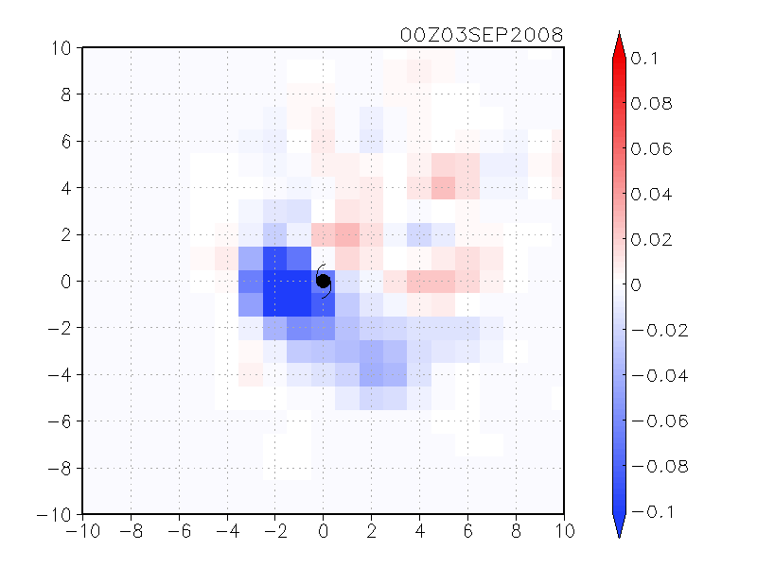
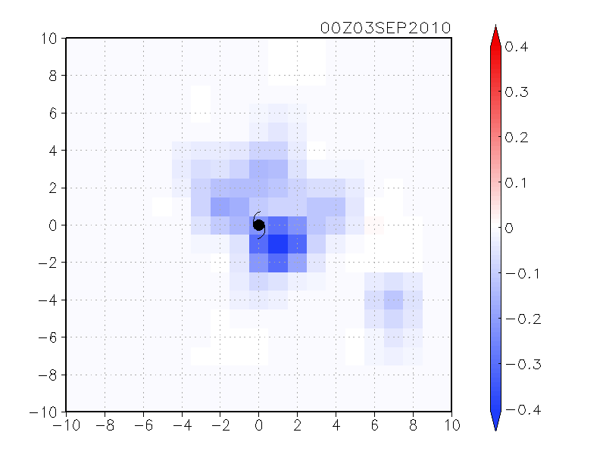
Composite of dropsonde impact over many TCs
Dropsonde impact (J kg⁻¹) per observation count
Location relative to the TC center
T-PARC 2008
ITOP 2010
N
Further statistical investigations are currently in progress.

Slide 33
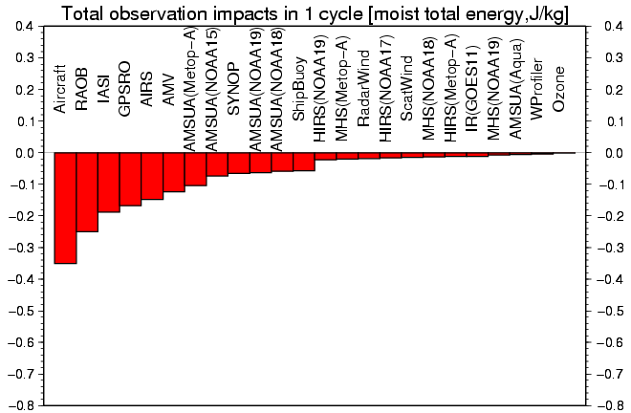
Obs impacts in NCEP GFS (Y. Ota)
moist total energy norm
Y. Ota (2012)
Improving
Averaged over 10/21-28, 2010 (28 samples)

Slide 34
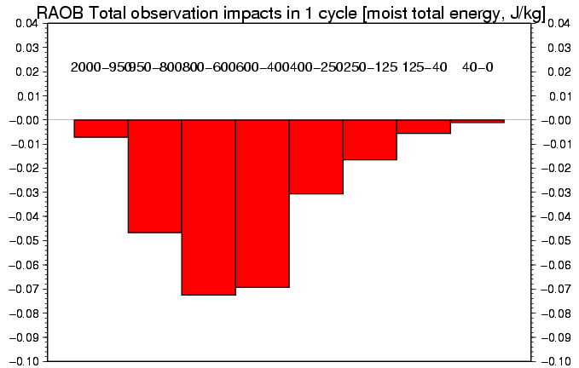
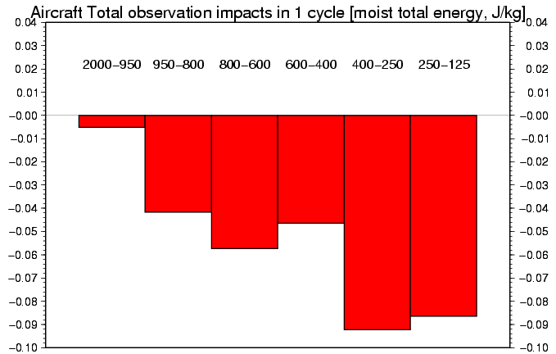
RAOB & aircraft at each level
Mid-troposphere RAOB (800 ~ 400 hPa) are helping the most.
RAOB
Y. Ota (2012)
Aircraft is most helpful at upper troposphere (400 ~ 125 hPa) probably because of the large number of obs around the flight level (~250 hPa).
Aircraft

Slide 35
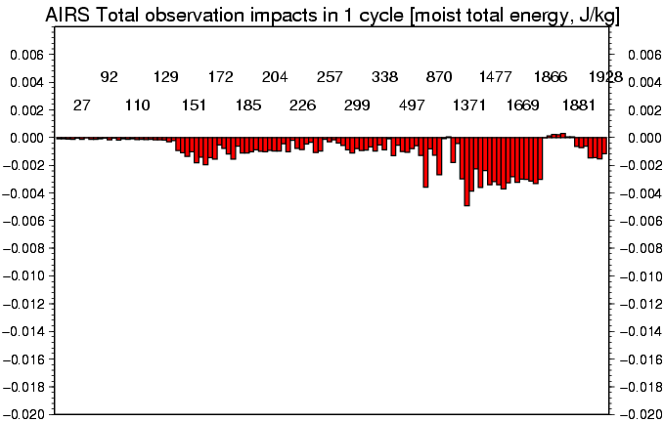
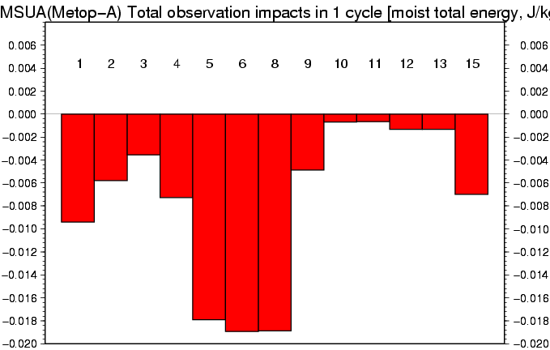
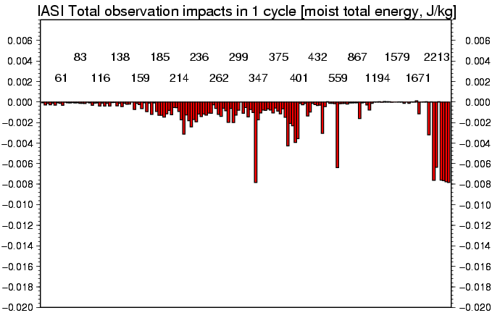
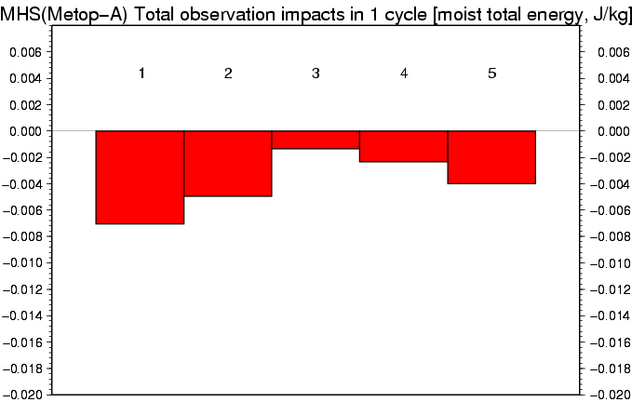
Satellite obs impacts in NCEP GFS
AIRS channels
AMSU-A
IASI channels
MHS
Y. Ota (2012)

Slide 36
two-way nested LETKF
WRF-LETKF: towards efficient experiments at a higher resolution
Miyoshi and Kunii (in preparation)

Slide 37
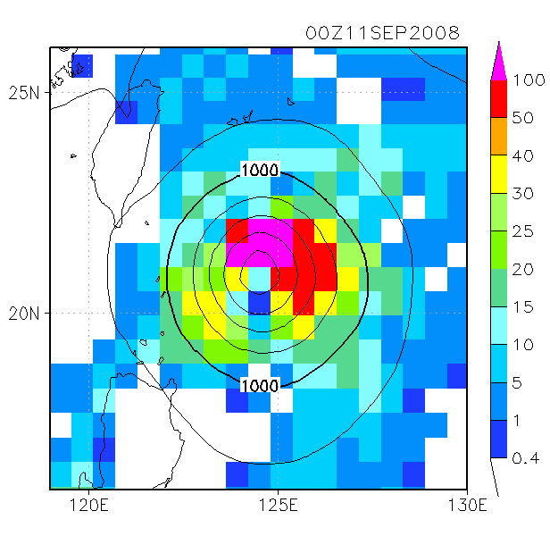
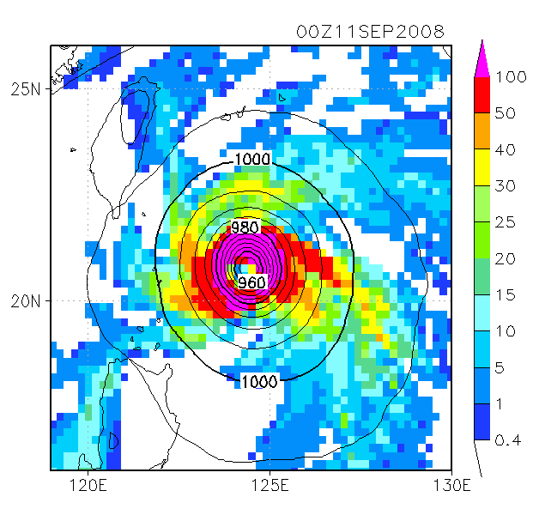
Motivation for higher resolution DA
60/20-km 2-way nested analysis
60-km analysis

Slide 38
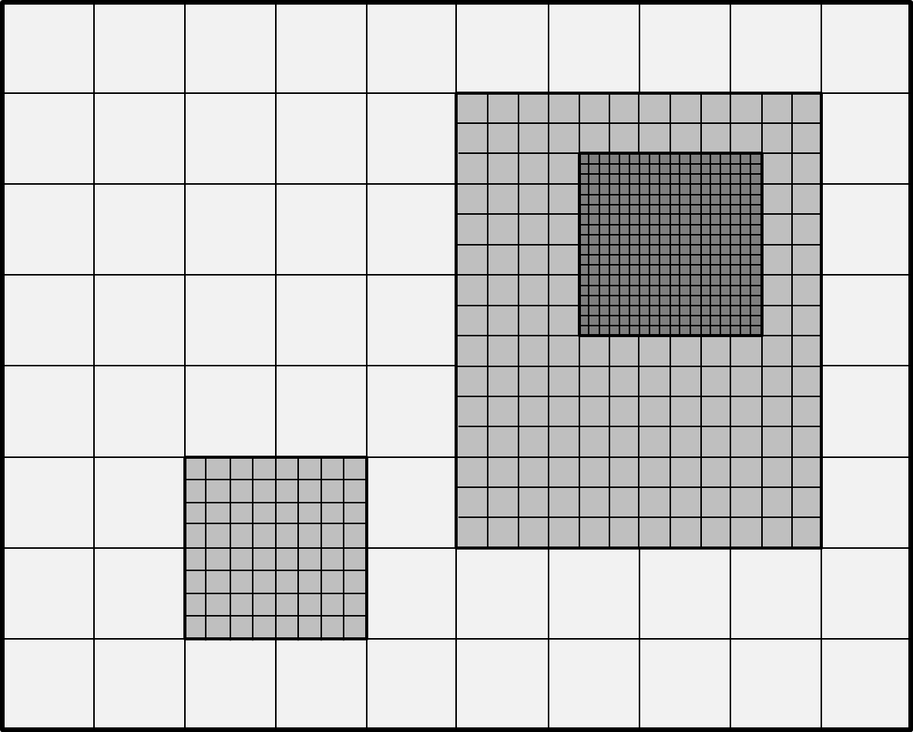
An example of heterogeneous grids

Slide 39
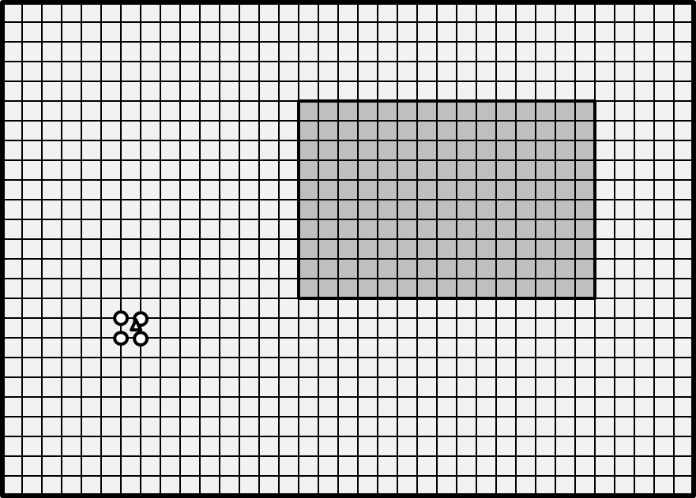
LETKF with heterogeneous grids
Heterogeneous grid
High-resolution homogeneous grid
Step1: Linear interpolation
The existing LETKF can deal with the homogeneous grid.
Multiple domain forecasts are treated in the single LETKF analysis step.
Observation operators are not affected.

Slide 40
Efficient implementation
Step2: Skip analyzing unnecessary grid points
Taking advantage of the independence of each grid point in the LETKF, having a simple mask file enables skipping unnecessary computations.
Additional I/O could be a significant drawback.

Slide 41
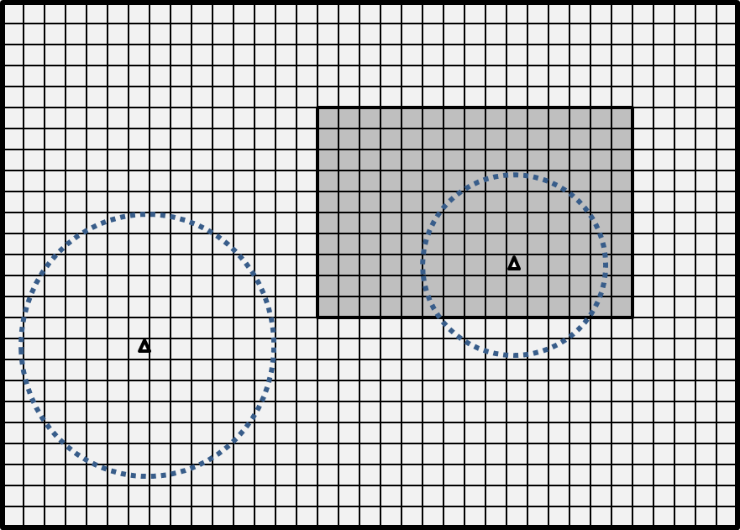
Enhanced localization
We can define different localization scales at each grid point.
We may want to have tighter localization in the higher-resolution region(s).

Slide 42
List of experiments
Experiments | Forecast | Analysis resolution | Localization
CTRL | 60/20-km 2-way nest | 60-km only | 400 km
2WAY | 60/20-km 2-way nest | 60/20-km heterogeneous | 400 km
2WAY-LOC | 60/20-km 2-way nest | 60/20-km heterogeneous | 200 km for the inner domain, 400 km elsewhere
60KM | 60-km only | 60-km only | 400 km

Slide 43
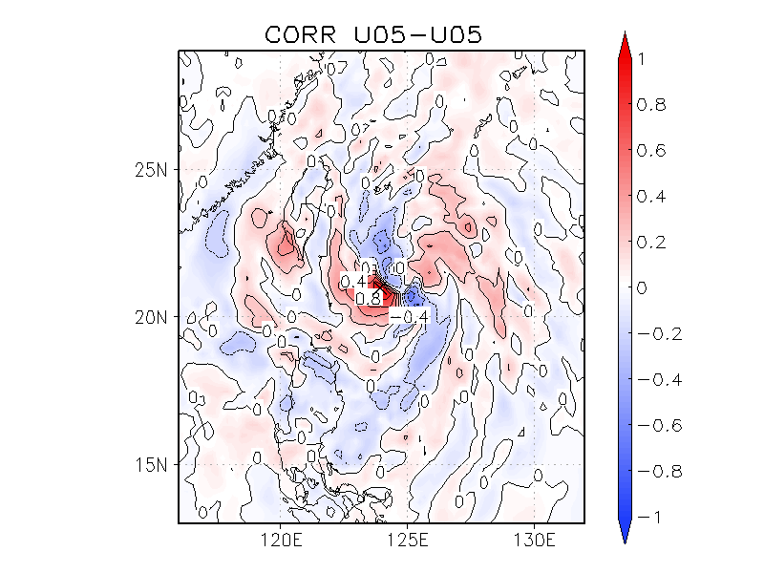
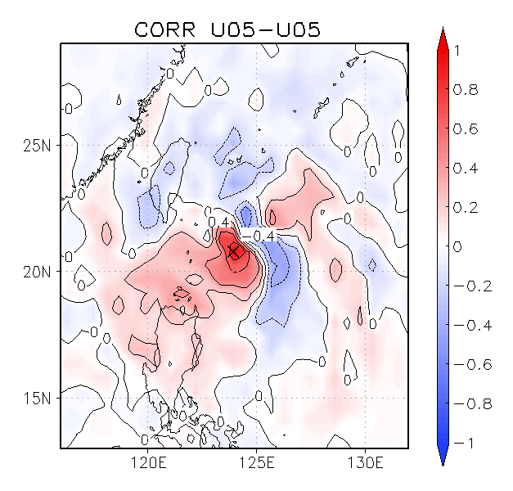
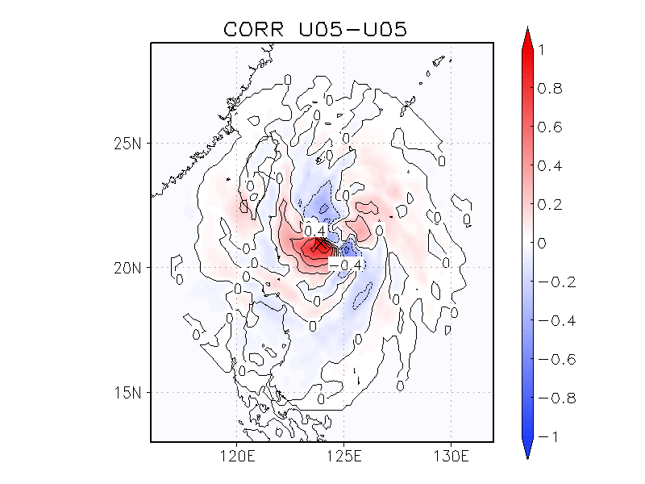
Covariance structure near Sinlaku
2WAY
60-km grid spacing
400-km localization
20-km grid spacing
400-km localization
CTRL
2WAY-LOC
20-km grid spacing
200-km localization

Slide 44
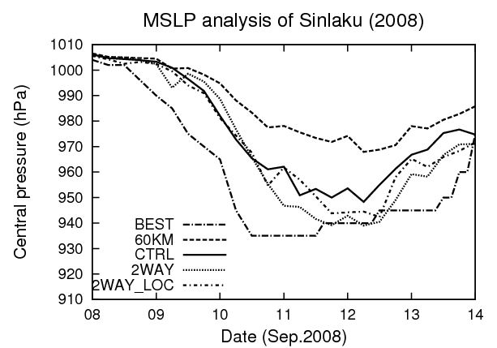
Results: better representing Sinlaku

Slide 45




Analysis increments and analysis
0600 UTC, September 9, 2008: Best track 985hPa
CTRL
60-km resolution increments
2WAY-LOC
20-km resolution increments

Slide 46

A single case intensity forecast
Intial time: 0000UTC September 10, 2008
Without assimilating dropsondes
Dropsonde data played an important role in higher-resolution data assimilation in this case.

Slide 47
Future plans

Slide 48
Plans
Further analysis and forecast
  Investigating air-sea coupled covariance around TC
    CFES-LETKF analyses and forecasts
  Higher-resolution runs (convection permitting ~5 km)
  Predictability studies by ensemble prediction
    Comparing ensemble members and evolution of perturbation fields will have insights about physical mechanisms of formation/intensification
  Statistical analysis of impacts of dropsonde data
    Composite analysis, etc.

Slide 49
Ideas for future project
R2O considerations
  Applying WRF-LETKF to the COAMPS-TC / HWRF
  Train students to be familiar with operational systems
Scientific Challenges
  Mesoscale Air-Sea-Coupled Data Assimilation
    Insights from our research on SST perturbations encourage further studies in this direction.
    Best use of AXBT ocean profiles (TCS-08/ITOP-10)
  Model parameter estimation
    LETKF can estimate model parameters using observations
    Boundary-layer physics, convection, etc.
    Even surface fluxes can be estimated (Kang and Kalnay)

Slide 50
The LETKF code is available at:
http://code.google.com/p/miyoshi/

