Slide 1

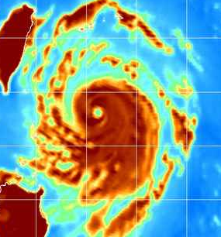


Achieving Superior Tropical Cyclone Intensity Forecasts by Improving the Assimilation of High-Resolution Satellite Data into Mesoscale Prediction Models
PIs: Chris Velden (CIMSS/U. Wisconsin)
Sharan Majumdar (RSMAS/U. Miami)
Co-PIs: Jim Doyle and Jeff Hawkins (NRL-Monterey)
Jeff Anderson and Hui Liu (NCAR), Jun Li (CIMSS/U. Wisconsin)
Collaborators: Bob Atlas (NOAA/AOML), John Knaff (NOAA/NESDIS), William Lewis (CIMSS / U. Wisconsin), Alex Reinecke, Song Yang, Hao Jin (NRL)
Ph.D. Student: Ting-Chi Wu (RSMAS/U. Miami)
NOPP Topic Review, RSMAS/U. Miami. 3/2/12

Slide 2
Overarching Goals
Development and refinement of a novel approach to supplement contemporary atmospheric observation capabilities with optimal configurations and assimilation methodology that takes advantage of advanced full-resolution satellite-derived observations in order to improve high-resolution numerical analyses and intensity forecasts of tropical cyclones (TCs).
Provide a pathway towards advanced satellite data assimilation (DA) in operational TC forecast models.

Slide 3
Approach
Use multiple and integrated satellite data sets at their full resolution in a high-resolution analysis/forecast system for tropical cyclones.
Provide a database of full-resolution observations from multiple satellite platforms for selected TCs.
Quantify how best to integrate these multiple datasets using advanced high-resolution models and DA.
Explore EnKF-based DA within NCAR WRF/DART and Navy system frameworks. Can extend to NOAA systems.
With current satellite data spatial resolutions, a 27/9 km nested analysis framework may be initially adequate.

Slide 4
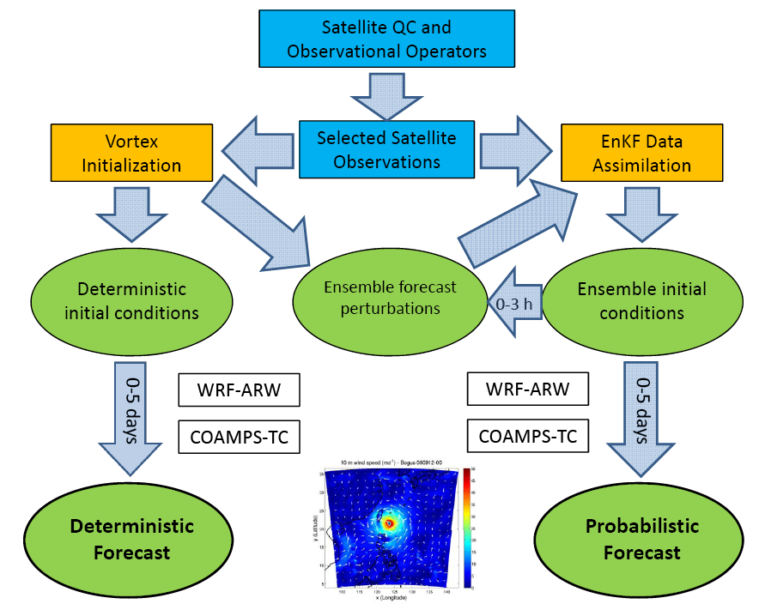
WRF-ARW
COAMPS-TC
HWRF
WRF-ARW
COAMPS-TC
HWRF

Slide 5
Year 1 : Assembling pieces …
Identified TC cases: Typhoon Sinlaku (2008) and Hurricane Ike (2008)
Enhanced satellite datasets processed and archived at CIMSS and NRL Monterey
Further improved retrieval algorithms
Commenced data assimilation experiments in WRF/ARW and COAMPS-TC
Diagnostics and comparisons against data

Slide 6
Years 2-3: Specialized experiments
Introduction of hourly and rapid-scan AMVs
Prepared QC’d AIRS SFOV clear sky soundings
Preparing AIRS SFOV cloudy soundings
MODIS and AMSR-E Total Precipitable Water
EnKF assimilation using bogus vortices
Combined satellite data in assimilation
Advancement of COAMPS-TC and WRF-ARW in DART.
Ported onto NOAA HFIP Jet.
Investigated ensemble size; localization; inflation
Advanced diagnostic tools
Preparation of ensemble forecasts

Slide 7
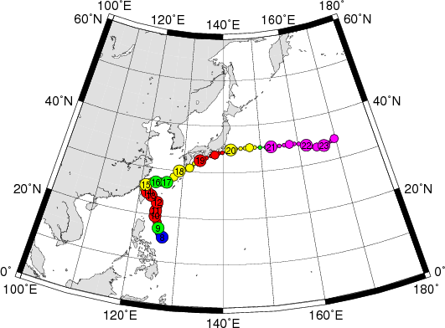
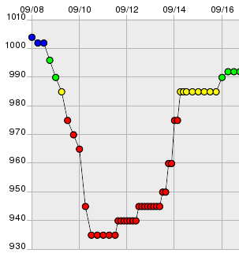
Typhoon Sinlaku (2008)

Slide 8
Upgraded data assimilation at NCAR
Revised WRF/DART system:
  Ensemble size is increased from 32 to 84
  Microphysics: WSM 5 classes is updated to WSM 6 classes
32 versus 84 members
  Analyses using CIMSS AMVs and routine observations are similar
  However, for AIRS-Q and TPW data, the differences are large
Sampling error correction showed little impact on the analyses.
Current localization cutoff distance was found to be the most effective (half-width cutoff = 650km).

Slide 9
EnKF Assimilation Experiments
WRF/ARW in DART. 32 and 84 ensemble members.
9km moving nest with feedback to 27km grid when TC is present.
Case | Non-Satellite | Satellite | Cycling interval
CTL | Radiosondes, aircraft data, JTWC advisory TC position data | AMVs from NCEP bufr file (source: JMA) | 6 hours
CIMSS(h) |  | Hourly AMVs from CIMSS | 3 hours
CIMSS(h+RS) |  | Hourly AMVs and Rapid-Scan AMVs (after 12UTC 10th Sep 2008) | 3 hours
AIRS T and Q |  | Single Field of View 15 km resolution soundings from CIMSS | 6 hours
TPW |  | AMSR-E TPW from CIMSS | 6 hours
ALL |  | AMVs(h+RS) + AIRS T and Q + TPW | 3 hours
Notes:
Assimilation is done on 27km, integrate the model forward by 9km

Slide 10
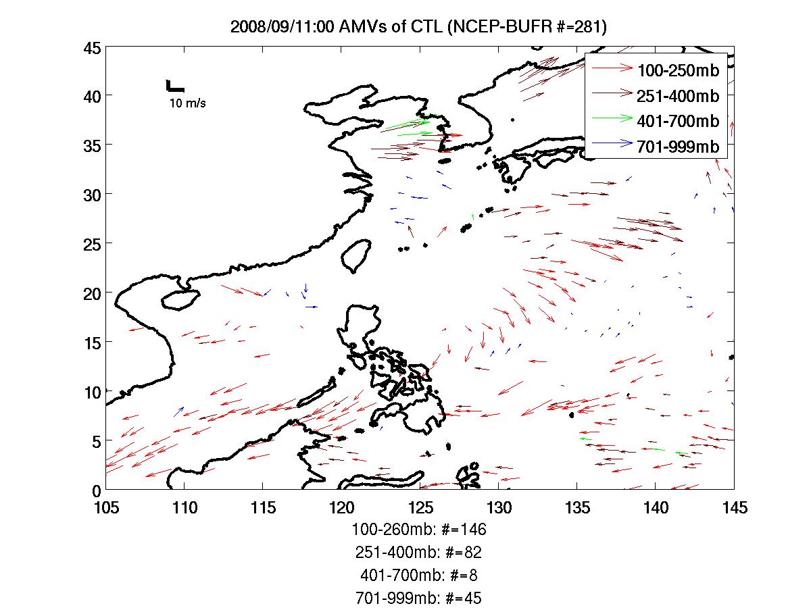
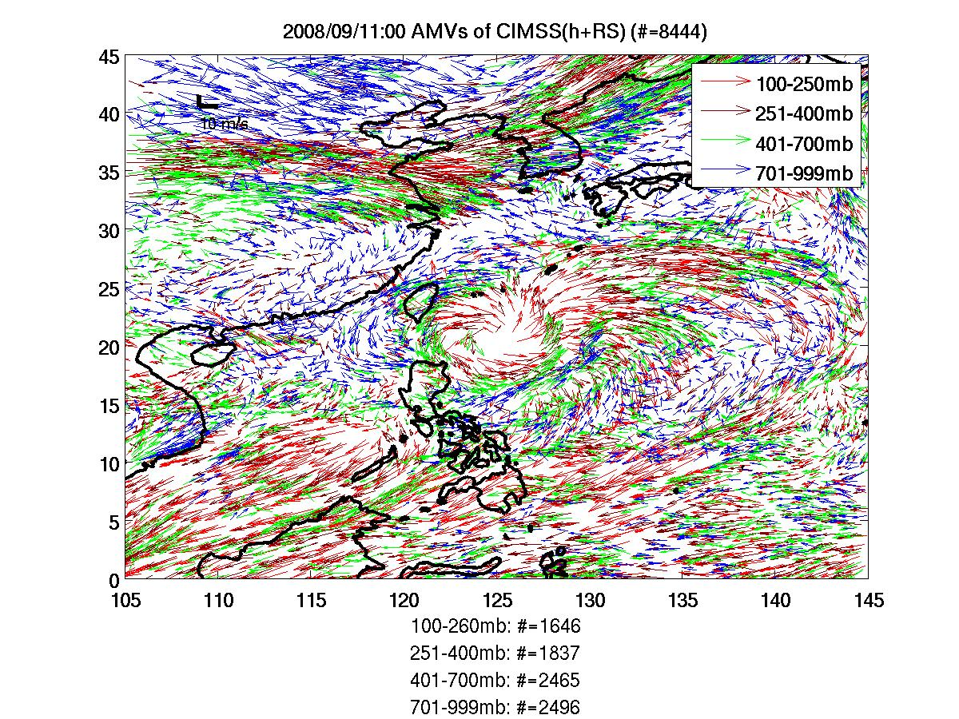
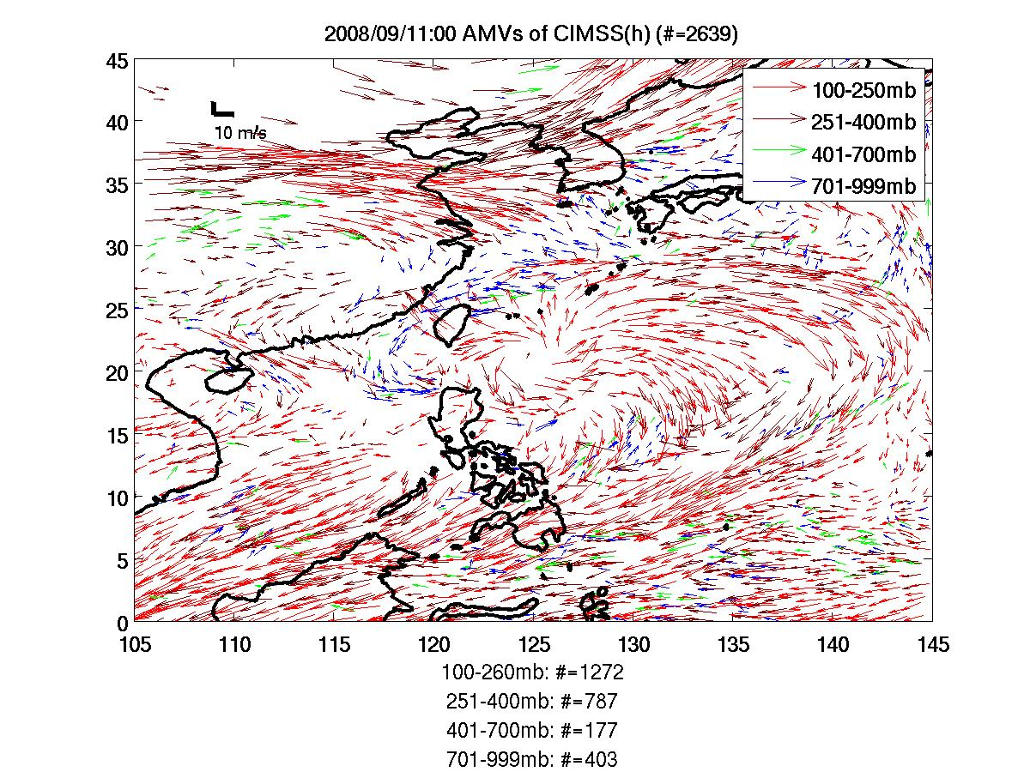
AMVs in the EnKF Cycles
701-999mb
401-700mb
251-400mb
100-251mb
Notes:
CIMSS(h) has almost 10 times more of AMVs than CTL, and most of it is from upper layer (400mb ).
CIMSS(h+RS) not only has an increased overall volume of AMVs, but also more AMVs at lower levels (400mb and below).

Slide 11
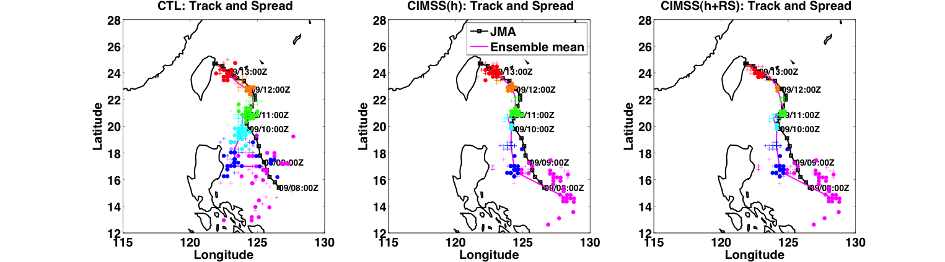
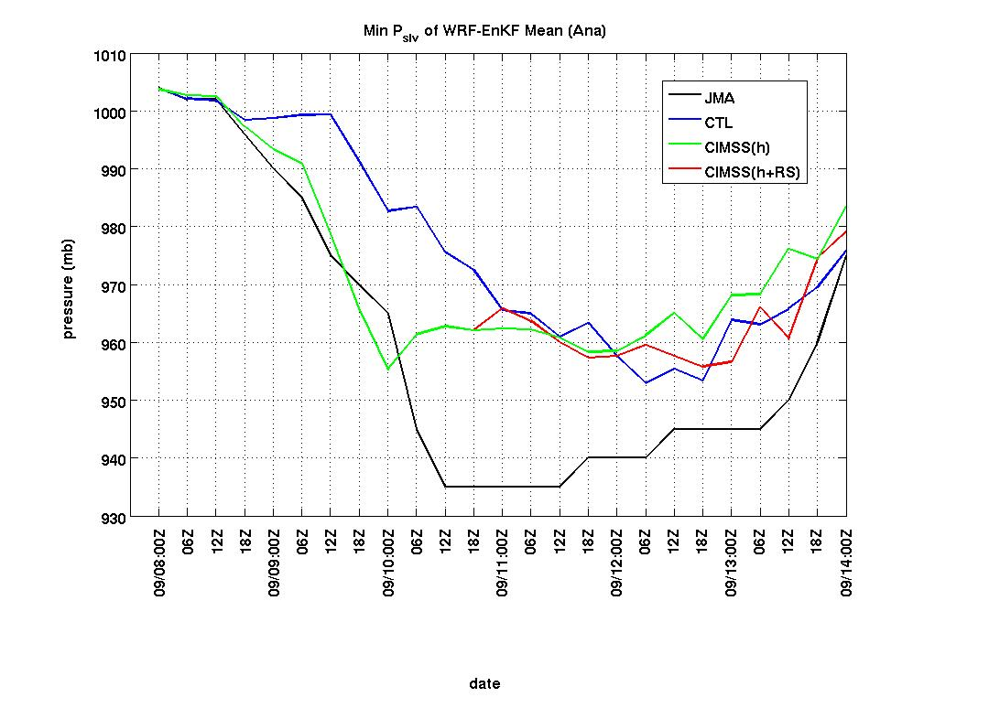
Analysis track and intensity (32)
MSLP
Notes:
The upper 3 panels are analyses track and spread against JMA best track in solid black line.
Colored dots are TC locations as a function of time from magenta to red.
A general narrower spread can be observed along the analysis time.
In the early state, CTL had an erroneously straight westward motion while CIMSS(h)

Slide 12
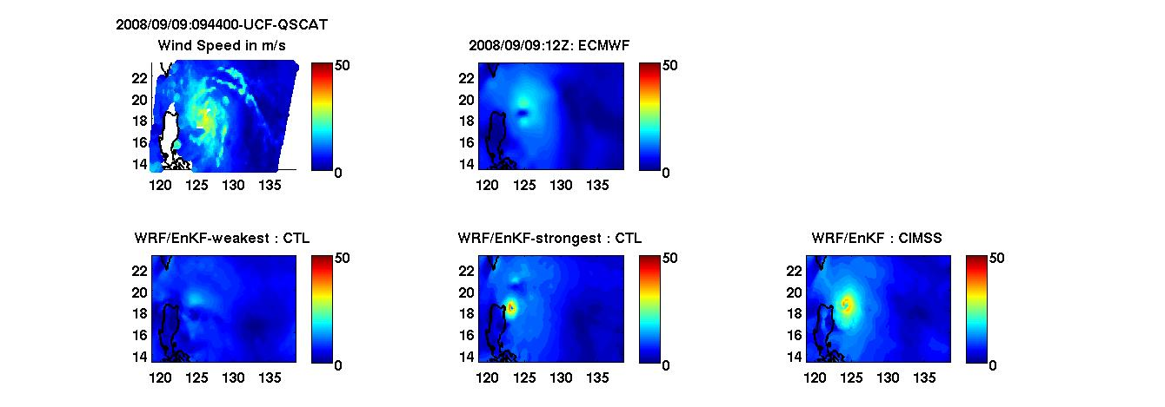
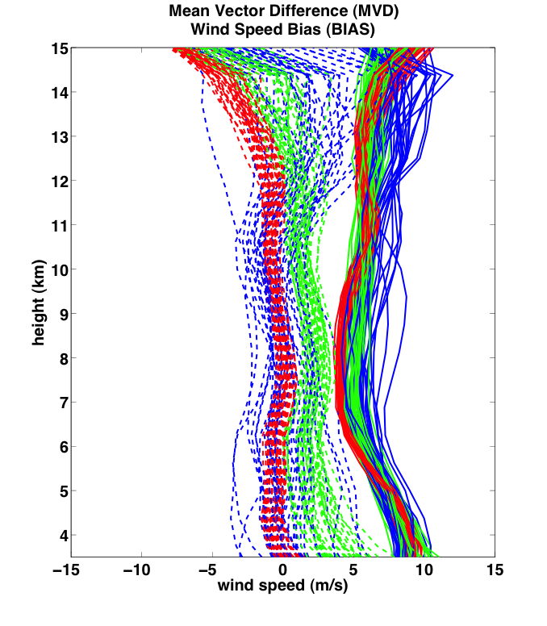
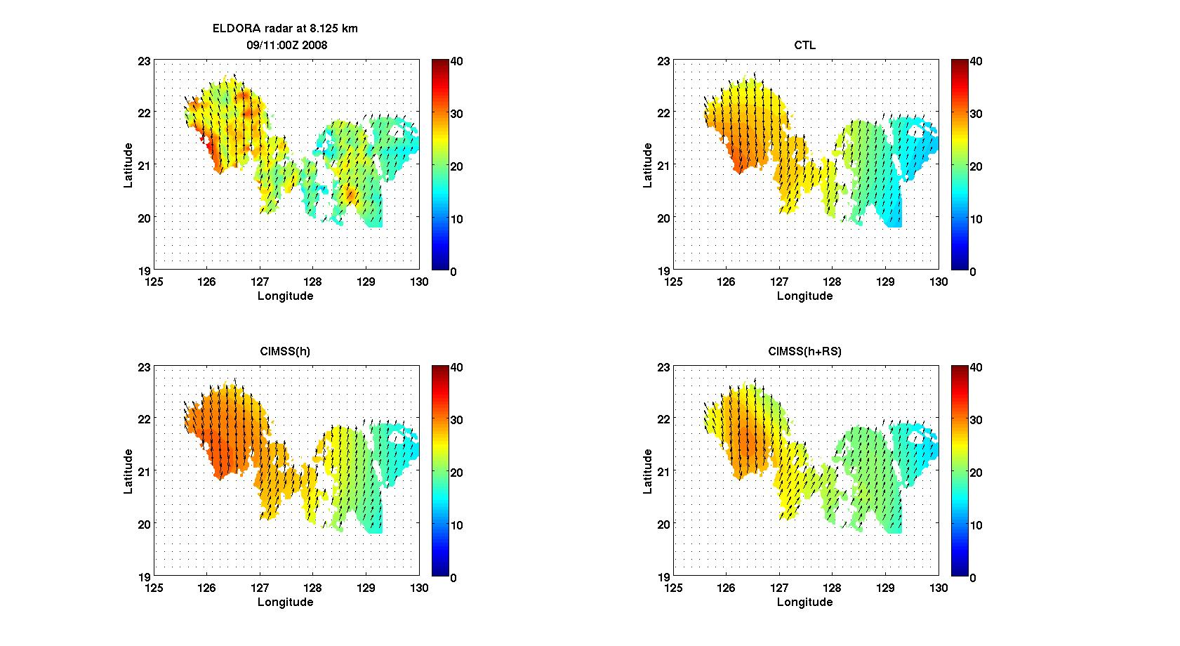
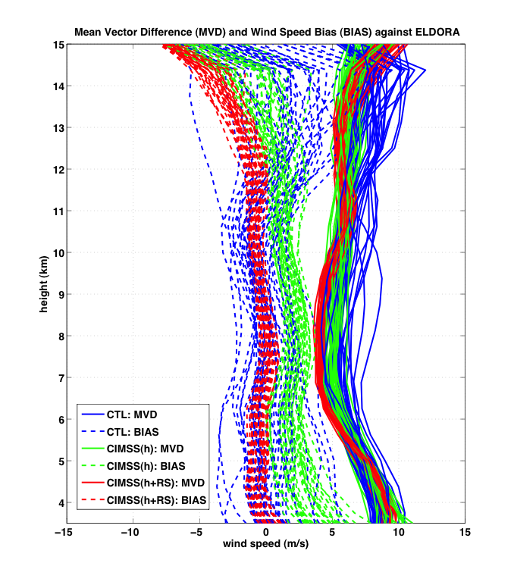
Analyses vs Independent Observations
QuikSCAT-UCF WD: 12 UTC 9 Sep
(h)
NRL P3 Eldora Radar WD: 00 UTC 11 Sep
ELDORA
CTL
CIMSS(h)
CIMSS(h+RS)
Notes:
25 km in QuikSCAT
3 km in Eldora Radar

Slide 13
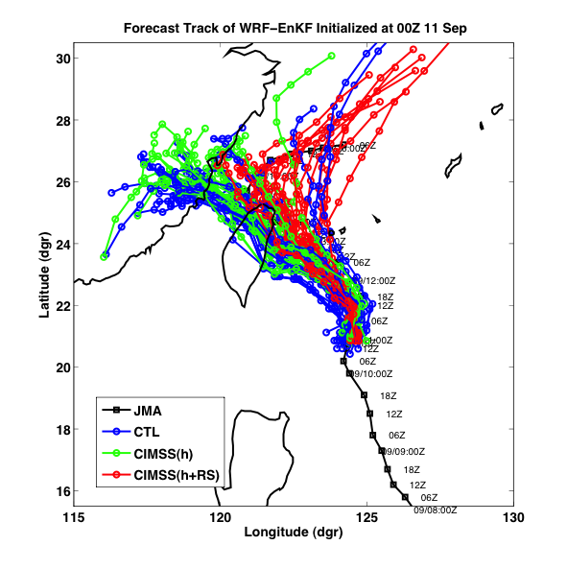
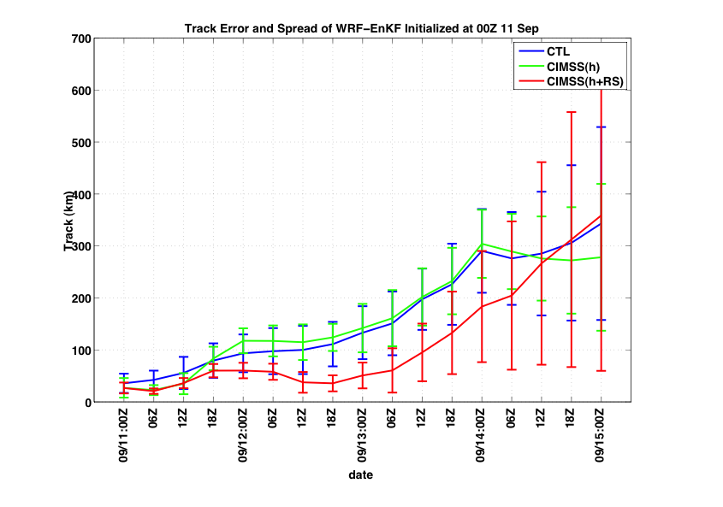
96-h WRF/EnKF Ensemble Forecasts
00 24 48 72 96

Slide 14
Conclusions from AMV study
Assimilation of CIMSS(h) improves the track, intensity and structure analyses in the earlier stage (including RI).
CIMSS(h+RS) wind analyses are most consistent with ELDORA observations throughout the vertical column.
On Sep 9th and 10th, ensemble mean track forecasts from CIMSS(h) outperformed CTL.
On Sep 11th, CIMSS(h+RS) produces the best ensemble mean track forecast.
  several members of CIMSS(h+RS) capture the recurvature.

Slide 15
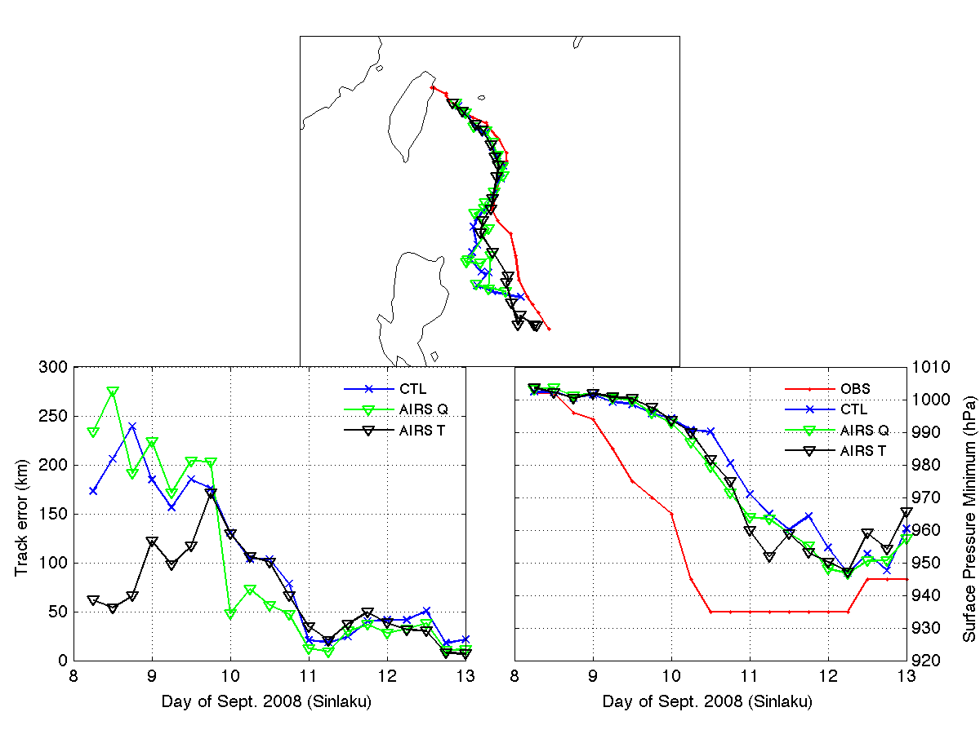
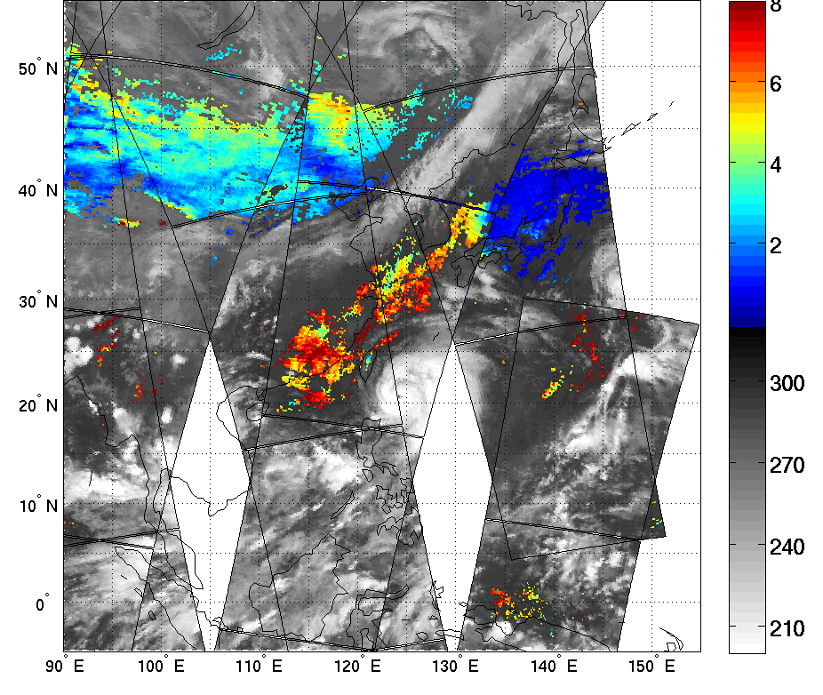
AIRS T and Q (84)

Slide 16
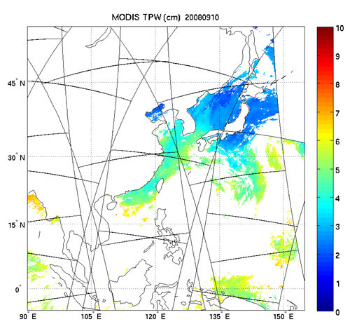
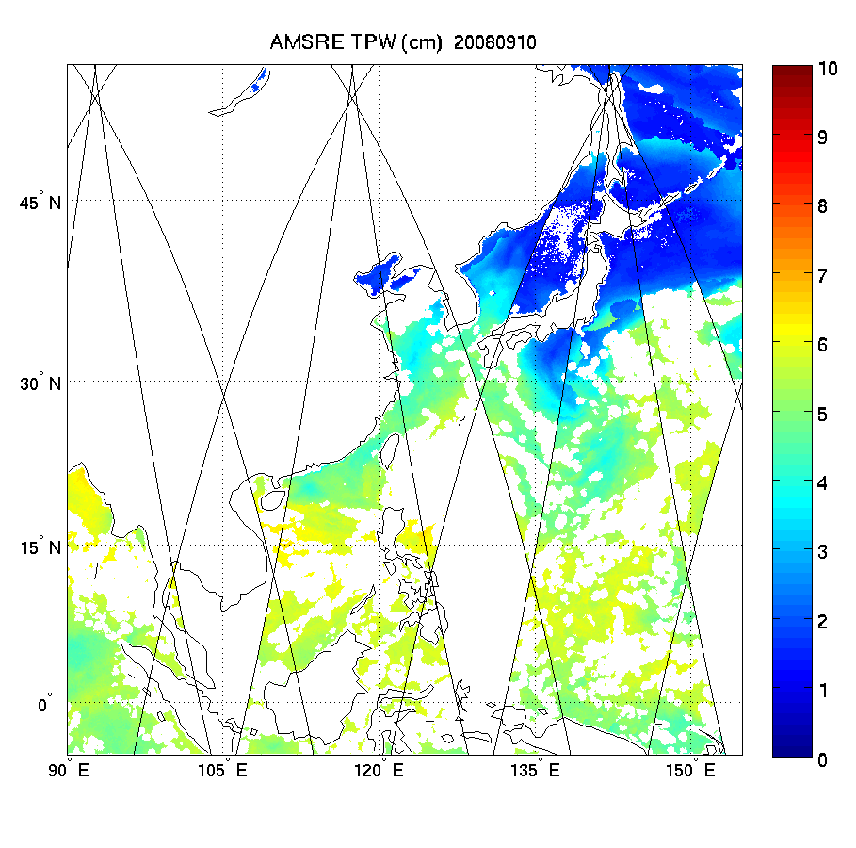
MODIS TPW (left) & AMSR-E TPW (right)
5 km res
17 km res

Slide 17
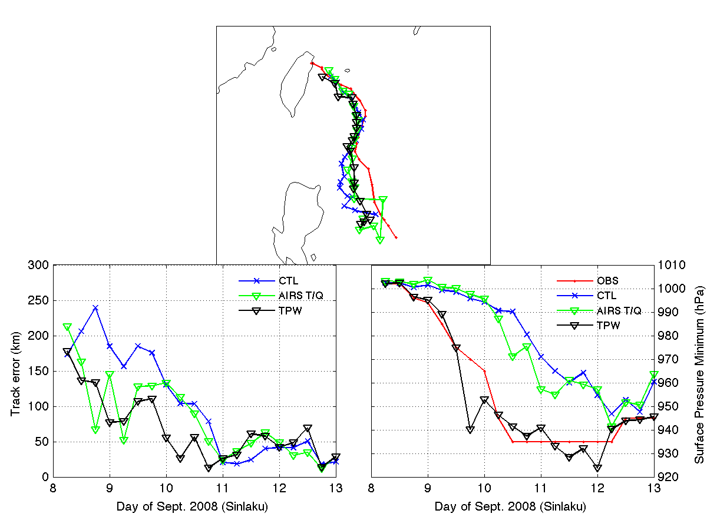
AIRS T and Q and AMSR-E TPW (84)
AIRS T&Q has positive impact on TRACK analysis
AMSR-E TPW has dramatic positive impact on INTENSITY analysis

Slide 18
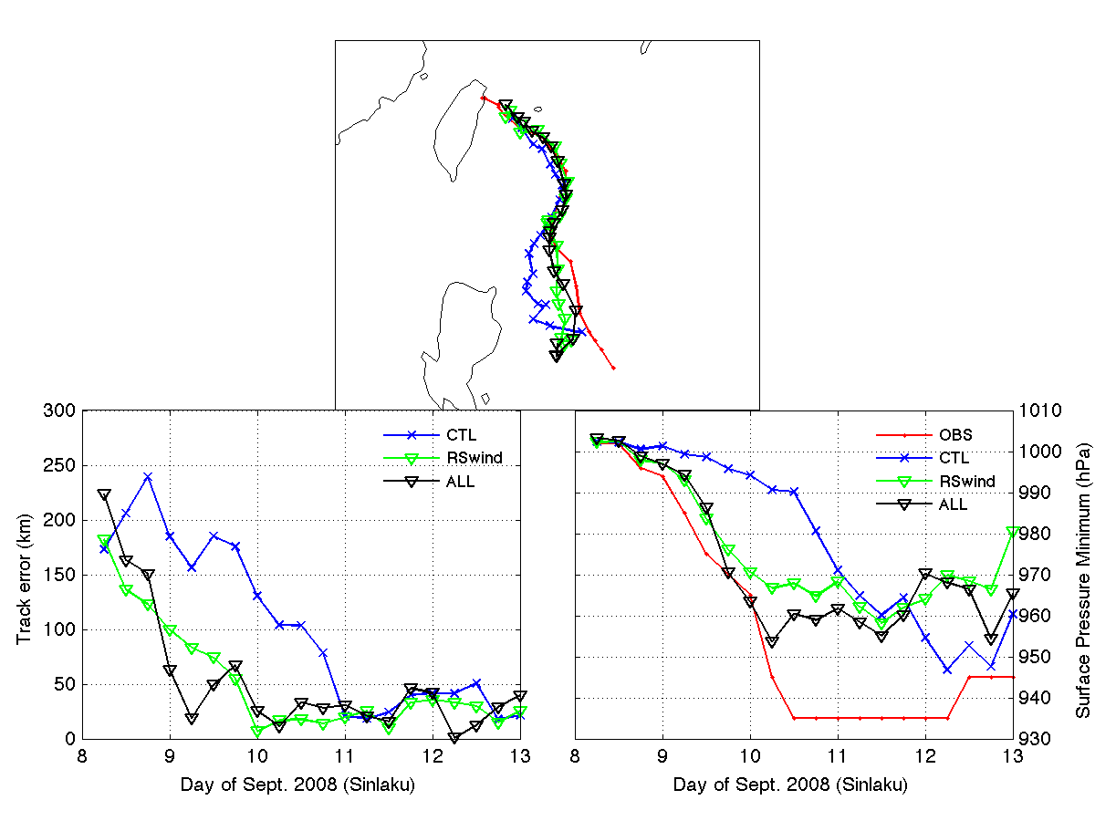
AIRS T and Q, AMSR-E TPW and AMVs (84)

Slide 19
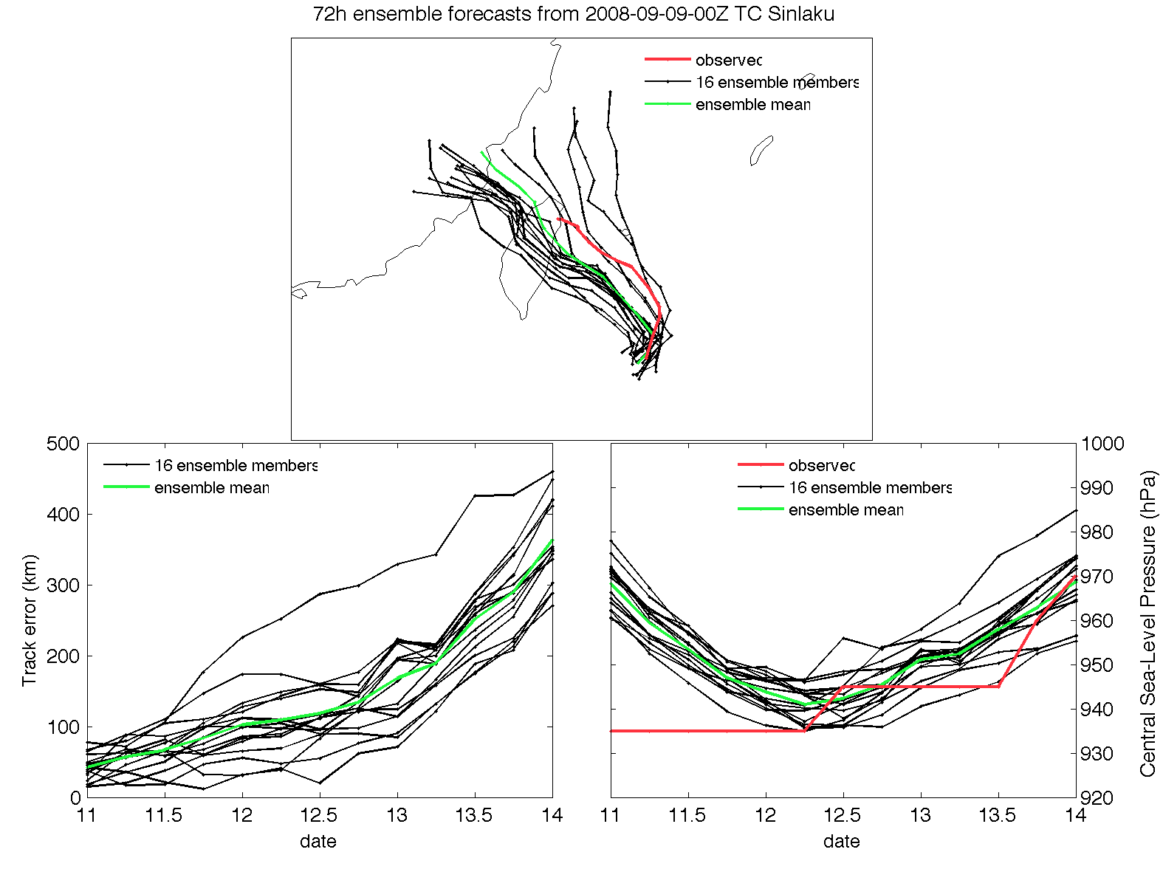
3-day Ensemble Forecast: CTL

Slide 20
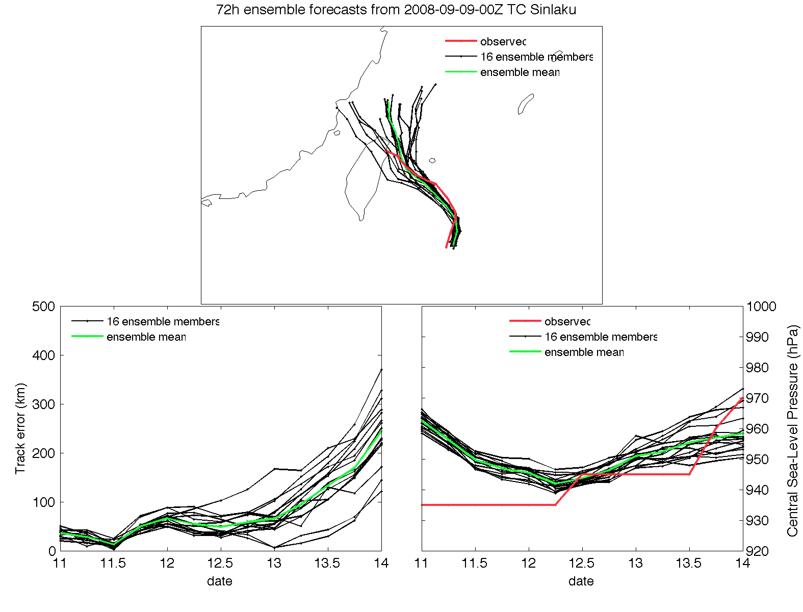
3-day Ensemble Forecast: ALL

Slide 21
Conclusions from T, Q, TPW studies
For assimilation of TPW and AIRS-Q, the larger ensemble size improves the analyses.
Assimilation of water vapor observations requires a much larger ensemble size than 32?
For AMVs, the larger ensemble size has little impact on the analyses.
AMV and TPW data have a particularly strong impact.

Slide 22

COAMPS-TC Ensemble System

Slide 23
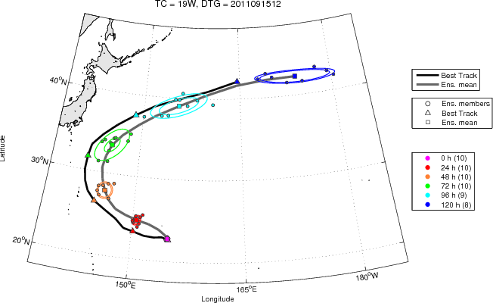
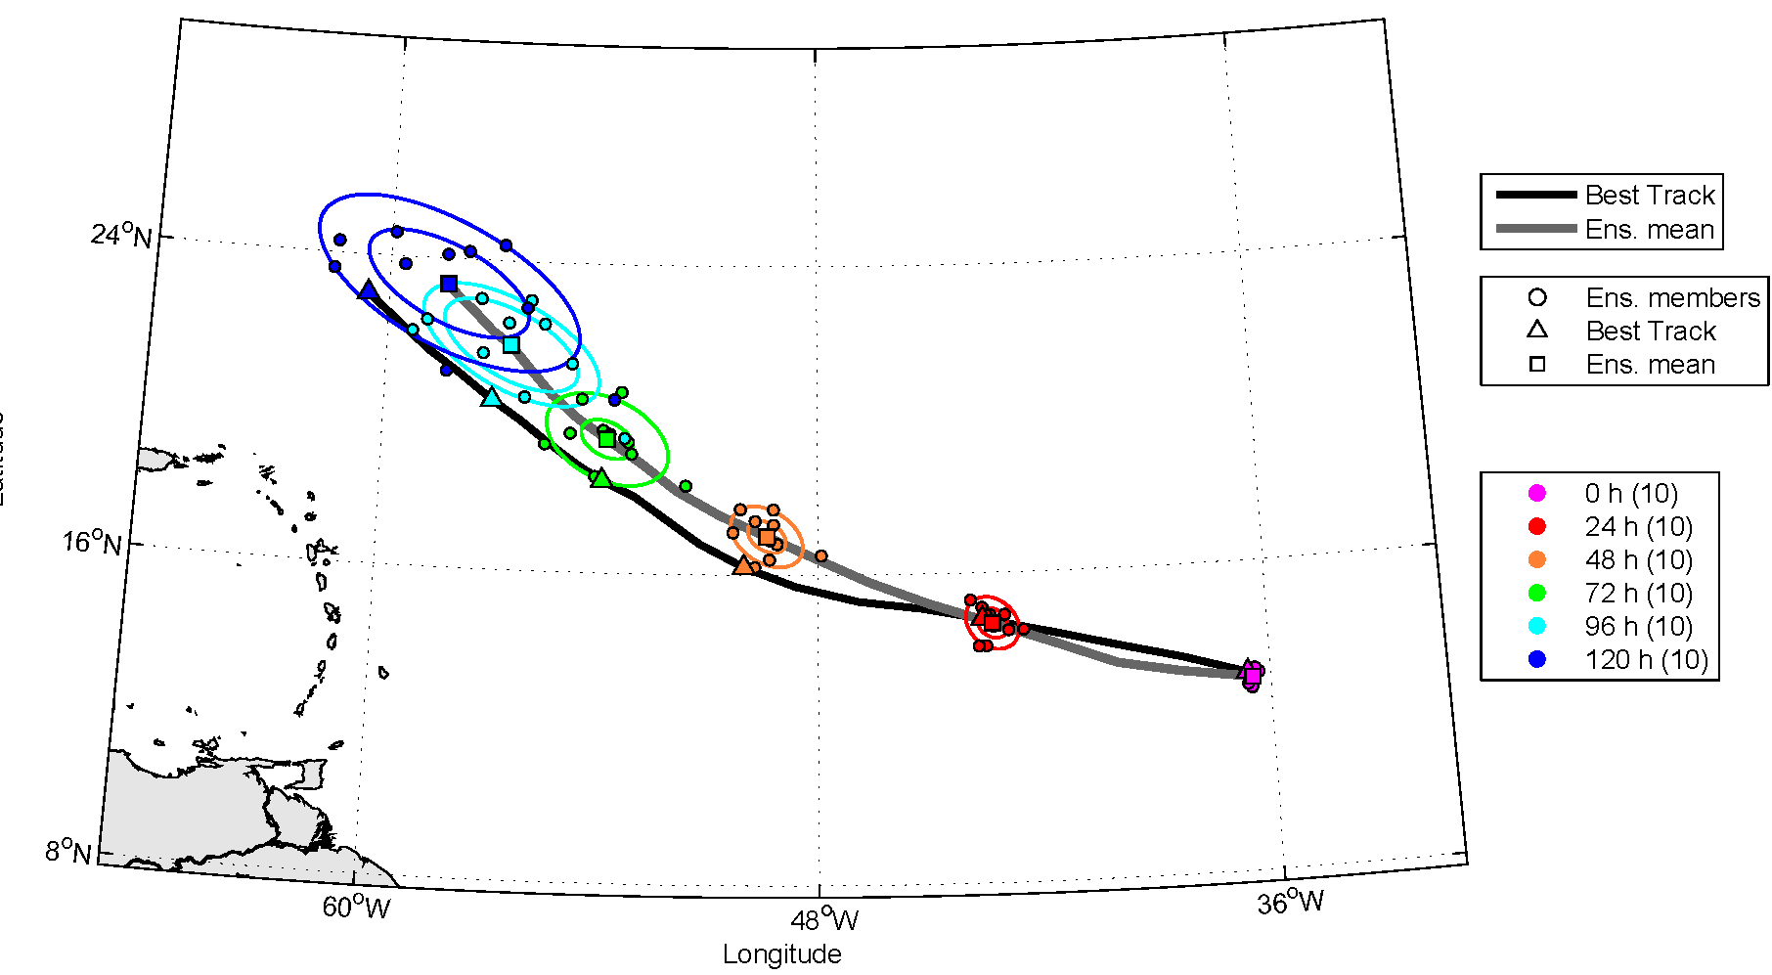
Real Time Evaluation
Sonca 2011 (WestPac)
12 UTC 15 September
Katia 2011 (Atlantic)
00 UTC 31 August
Over 250 real-time analyses and forecast made between August and September for the Atlantic and Pacific basins.
Track forecasts real-time probabilistic guidance for forecasters
Data set provides a control for data inclusion/denial experiments.

Slide 24
COAMPS-TC FY12 Experiments
For a subset of the 2011 real-time data set, perform a series of experiments with various observation sets added to the analysis.
Relatively large data set will allow for statistical significance testing.
Experiments to be performed:
  Assimilation of AMSU-A radiance observations from METOP and NOAA-15, 16 & 18 using global-model bias coefficients.
  Same AMSU-A experiment except using bias coefficients spun up with COAMPS-TC.
  Denial of AMV’s.
  Assimilation of TPW observations.
  Testing with a 3-hr update cycle (currently 6-hr is used).

Slide 25
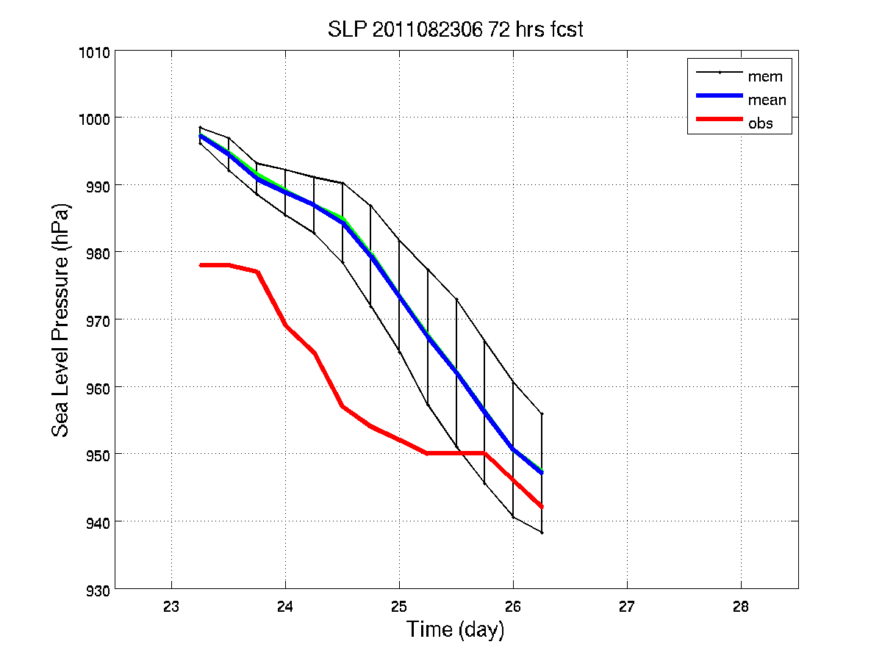
Other DA experiments
Hurricane Ike (2008)
  WRF/3d-Var 12 km: AIRS T and Q
  Improvement of track and MSLP forecasts
Hurricane Irene (2011)
  WRF/DART 36 km …
CTL
AIRS
Best

Slide 26
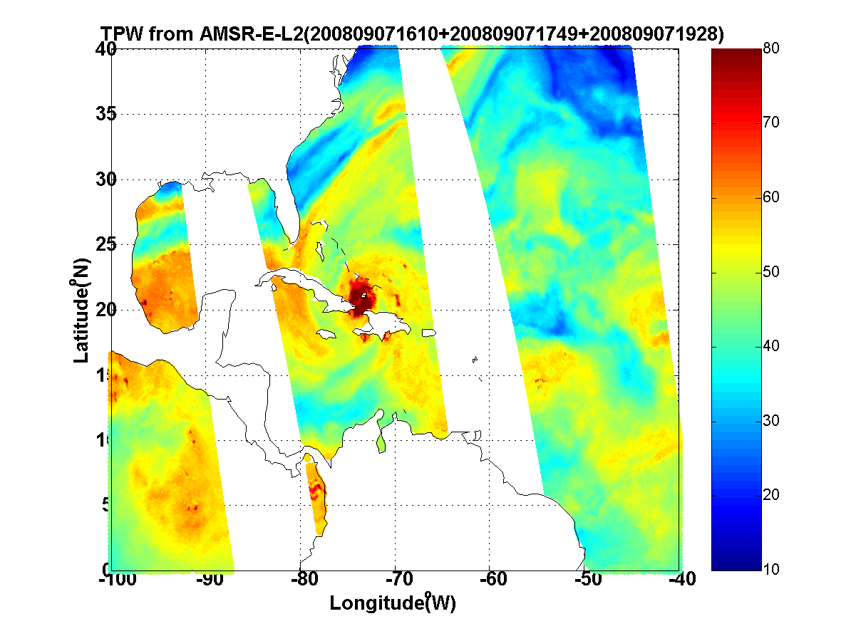
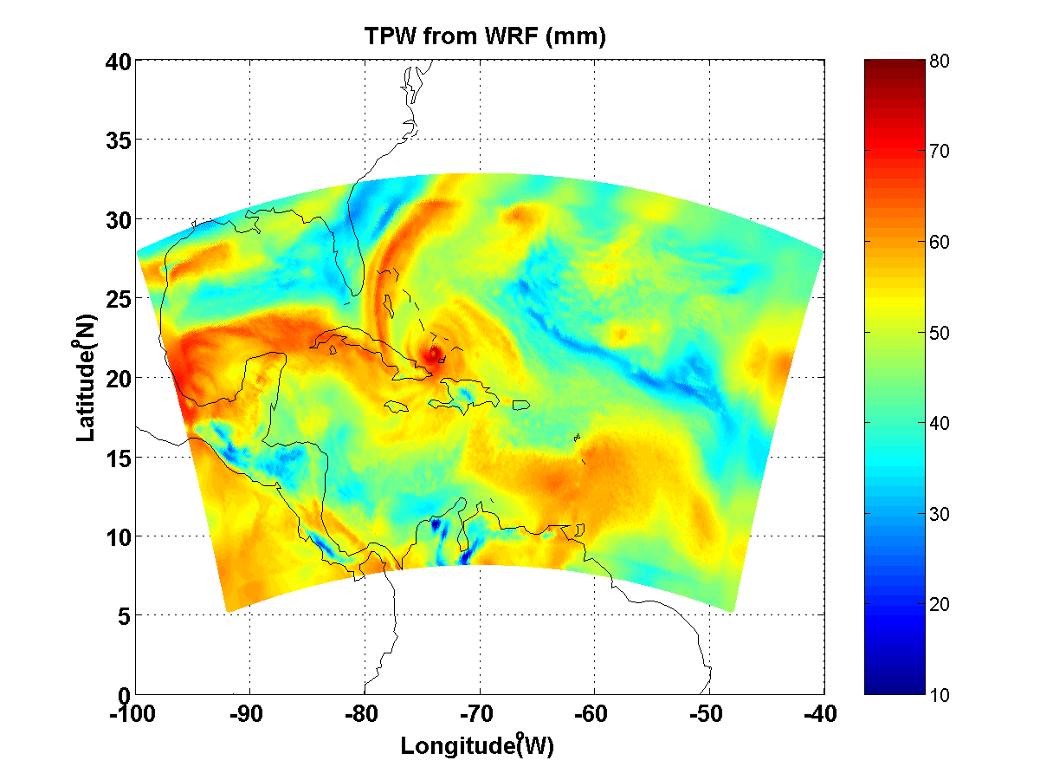
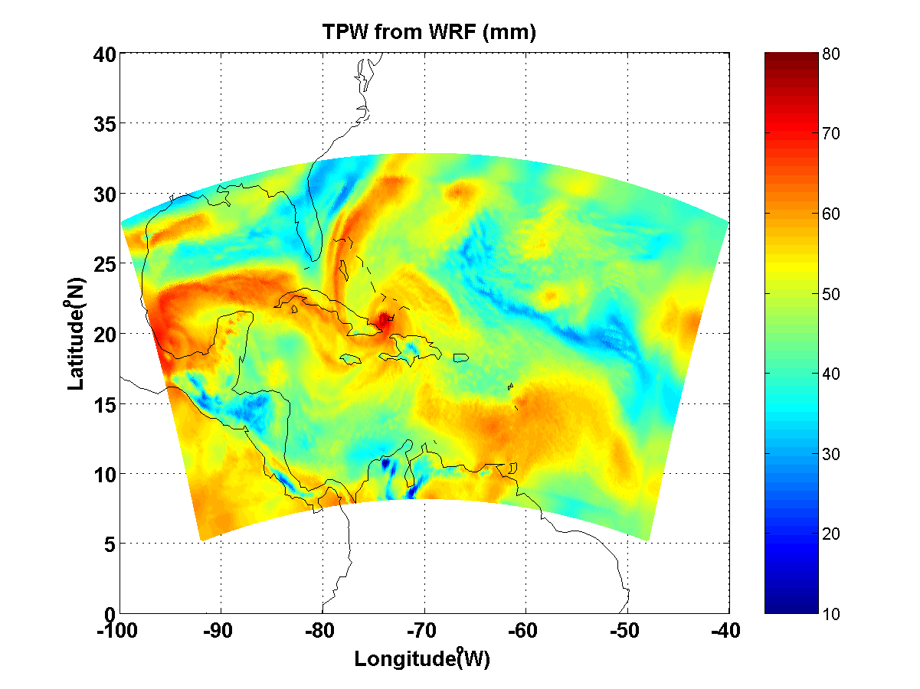
How to verify impact on forecast?
Traditional track / MSLP metrics
TC size (using CIMSS analyses)
Comparisons vs independent observations
Can use GOES images, AMSU, MIMIC …
e.g. TPW as a qualitative (and quantitative) metric

Slide 27
Main accomplishments
End-to-end system: satellite observations; DA; ensemble forecasts; verification; diagnostics
Usually, more observations = better!
Benefit from hourly and rapid-scan AMVs, and microwave TPW
Development of new verification and diagnostic tools
Demonstrated potential for operational use

Slide 28
Current and Future Work
Cloudy radiances being tested. Challenges with bias, figure out correction method.
Understanding relative impact of winds, temperature and moisture.
Include satellite surface winds: scatterometers
Other datasets
  Surface wind analyses from NESDIS
  AMSU-based products
  Microwave radiance channels
  Hyperspectral radiances

Slide 29
Potential Transitions
Follow-on studies will need to demonstrate the capability to assimilate in (near) real-time the special satellite datasets.
Try in an operational-like environment.
  Near real-time demo.
Compare results from research system versus operational analyses and forecasts.
In principle, can accumulate many cases.

Slide 30
Synergies with other projects
ONR TCS-08
  Enhanced AMVs in NOGAPS (PI Velden)
  TC sensitivity and initialization (PI Majumdar)
Advanced IR soundings (PI Li)
Related NCAR data assimilation projects
NRL COAMPS-TC data assimilation efforts
Leveraging components of NOAA HFIP

Slide 31
Relevant Publications
Doyle, J.D., C.A. Reynolds, and C. Amerault, 2011: Diagnosing tropical cyclone sensitivity. Computing in Science and Engineering, 13, 31-39.
Hendricks, E.A., J.R. Moskaitis, Y. Jin, R.M. Hodur, J.D. Doyle, and M.S. Peng, 2011: Prediction and Diagnosis of Typhoon Morakot (2009) Using the Naval Research Laboratory’s Mesoscale Tropical Cyclone Model. Terr. Atmos. Ocean. Sci., 22, (In Press).
Kwon, E.-H., J. Li, Jinlong Li, B. J. Sohn, and E. Weisz, 2011: Use of total precipitable water classification of a priori error and quality control in atmospheric temperature and water vapor sounding retrieval, Advances Atmos. Sci. (accepted).
Wu, T.-C., H. Liu, S. Majumdar, C. Velden and J. Anderson, 2012: Influence of assimilating satellite-derived atmospheric motion vector observations on analyses and forecasts of tropical cyclone track and structure. Mon. Wea. Rev. (in preparation)
Zheng, J., J. Li, T. Schmit and Jinlong Li, 2011: Assimilation of AIRS soundings for improving hurricane forecasts with WRF/3DVAR, J. Geophys. Res. (submitted).
Zheng, J., J. Li, T. J. Schmit, J. Li, and Z. Liu, 2012: Variational assimilation of AIRS temperature and moisture profiles for improving hurricane forecasts. J. App. Met. Clim. (in preparation)

Slide 32
Extra Slides

Slide 33
Datasets prepared at NRL Monterey
Data Name | Variables | Resolution | Coverage | Source
ASCAT Wind | Lat, lon, time, wind speed and direction, ECMWF wind speed & direction, wind flag | 25 km | Orbit | EUMETSAT
BYU QuickSCAT Wind | Lat, lon, time, wind speed & direction, surface type | 2.5 km, 25 km | 20x20 deg box following TC | BYU
UCF QuickSCAT Wind | Lat, lon, time, wind speed & direction, RR_flag, TB | 1/8 degree grid | 10 lat x 20 lon box following TC | UCF
NOAA Windsat EDR | Lat, lon, time, wind speed & direction, SST, TPW, CLW, RR, surface type | Pixel | Orbit | NOAA
NRL Windsat EDR | Lat, lon, time, SST, TPW, CW, RR, WSP_err, TPW_err, CLW_err | 25X35 km 35x53 km 50x71 km | Orbit | NRL
SSM/I EDR | Lat, lon, time, TPW, CLW, wind speed, RR, Wind_flag, surface type | Pixel and 1/3 degree grid | Orbit | NOAA/NESDIS
SSMIS EDR | Lat, lon, time, TPW, CLW, wind speed, RR, wind_flag, surface type | 1/3 degree grid | Orbit | NOAA
RSS EDR (AMSR-E) | Lat, lon, time, SST, Wind speed, TPW, CLW | 0.25 deg grid | Daily ascending & descending | RSS
RSS EDR (MWSST) | Lat, lon, SST | 0.25 deg grid | Daily | RSS
RSS EDR (QuikSCAT) | Lat, lon, time, wind speed & direction, RR, flag | 0.25 deg grid | Daily | RSS
RSS EDR (SSMI-F13) | Lat, lon, time, wind speed, TPW, CLW, RR | 0.25 deg grid | Daily | RSS
RSS EDR (TMI) | Lat, lon, time, SST, wind 11GHz, wind37GHz, TPW< CLW, RR | 0.25 deg grid | Daily | RSS

Slide 34
Other Satellite Datasets
NESDIS-RAMMB
  6-hourly, multi-platform TC surface wind analyses
  AMSU-based TC data and products

Slide 35
Datasets prepared: CIMSS/UWisc.
Enhanced fields of AMVs
- from MTSAT during West Pacific Typhoon Sinlaku (TCS-08 field program)
- from GOES for Atlantic Hurricane Ike (2008)
Hourly datasets
Use of rapid scans when available
Tailored processing and new quality indicators
  Observation confidence estimates; forward operator error estimates for DA

Slide 36
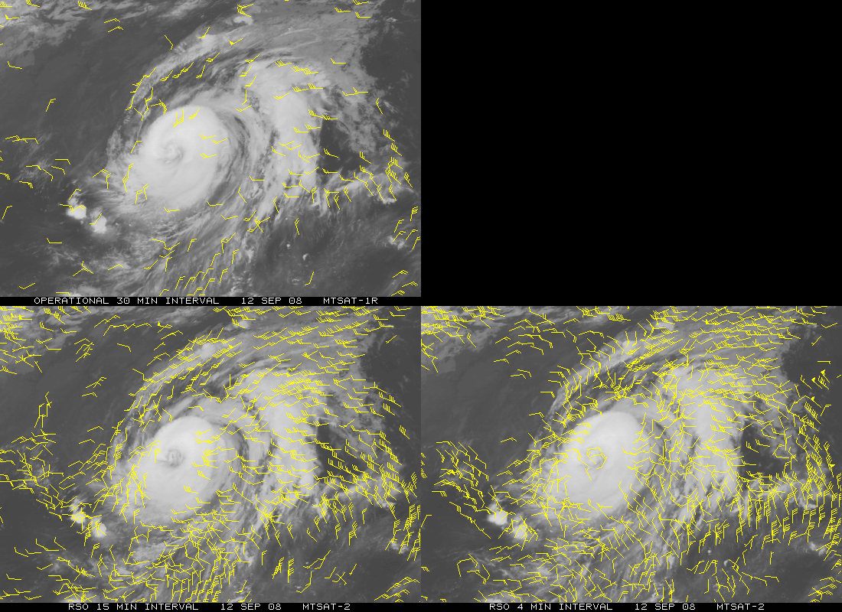
MTSAT AMV Example
Left: AMV (IR-only) field produced from routinely available hourly sequence of MTSAT-1 images during Typhoon Sinlaku
Bottom Left: Same as above, but using a 15-min rapid scan sequence from MTSAT-2
(better AMV coverage and coherence)
Bottom Right: Same as above, but using a 4-min rapid scan sequence (improved coverage/detail of typhoon flow fields)

Slide 37
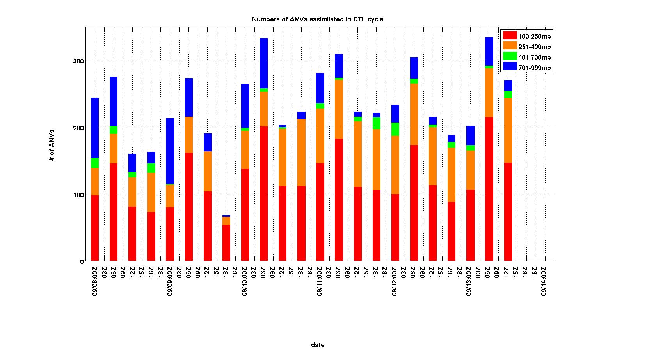
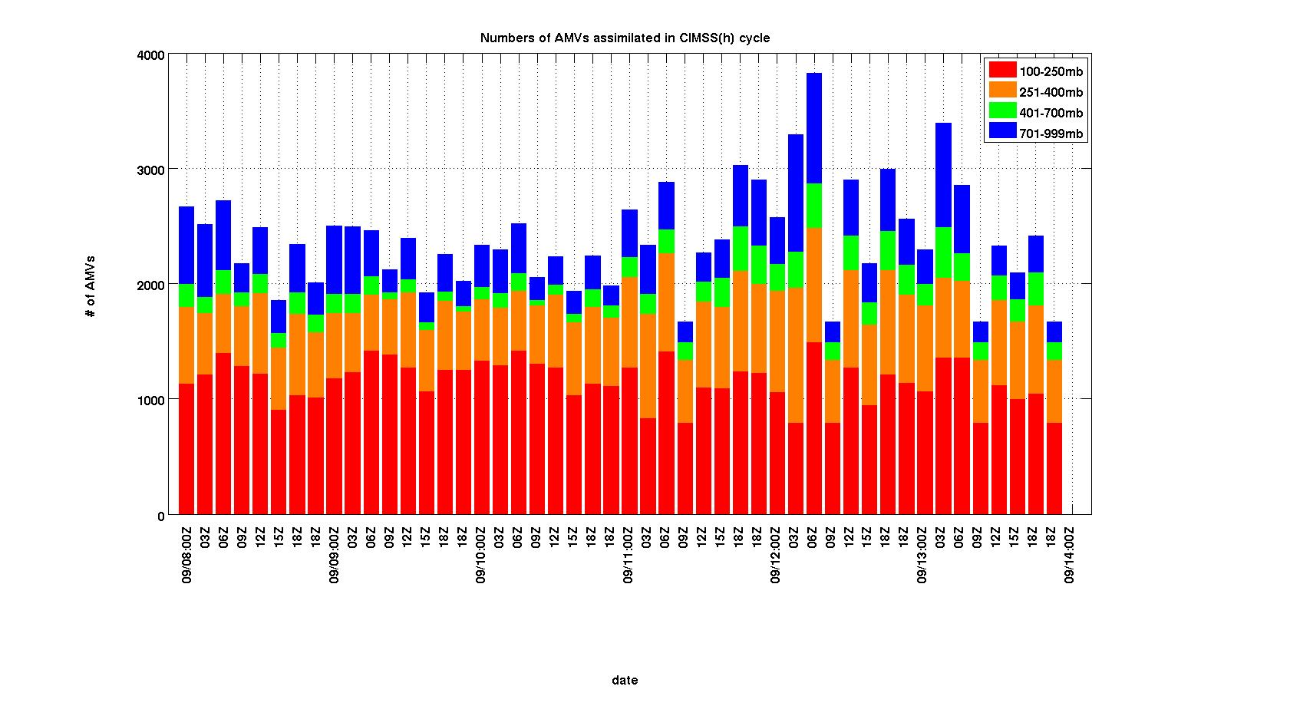
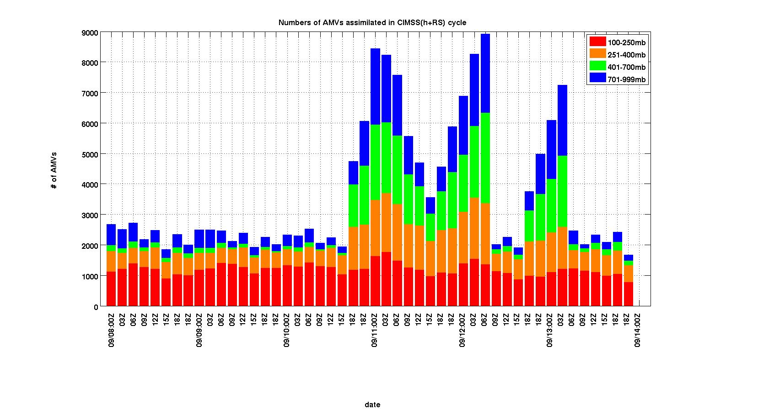

Slide 38
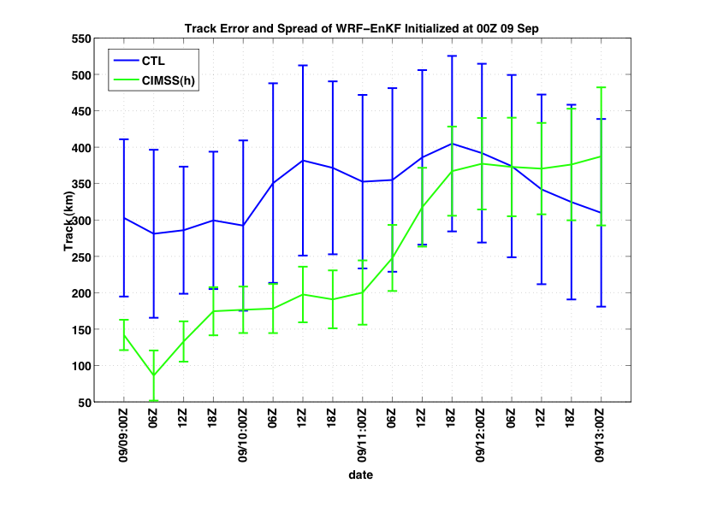
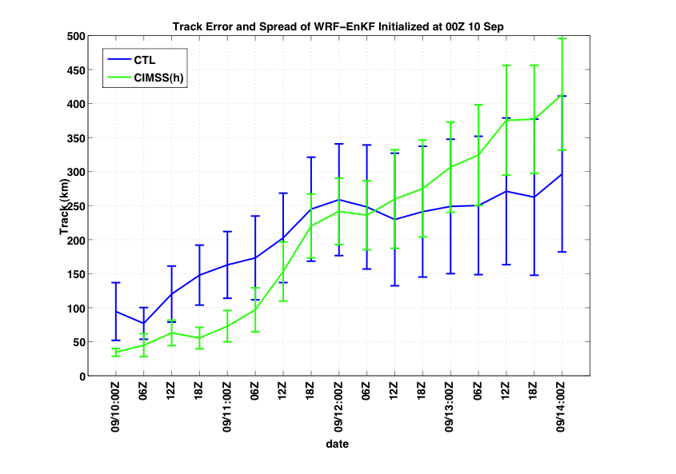
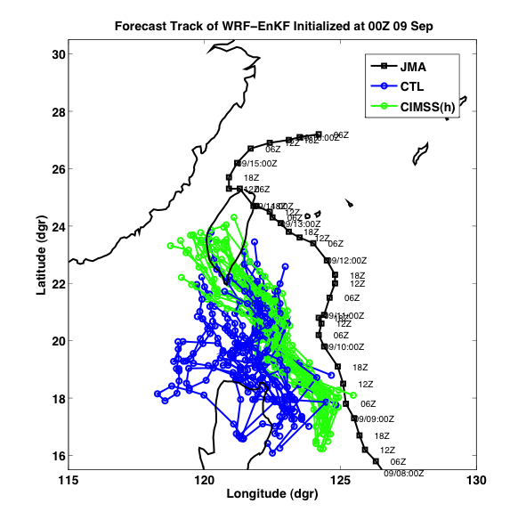
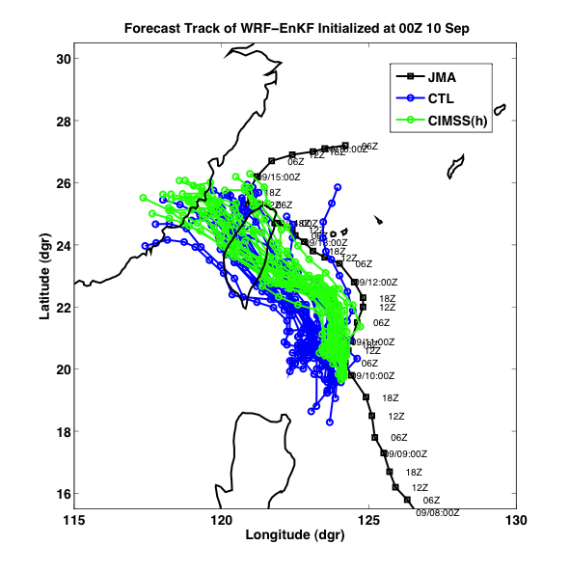
Forecast track error, spread and track
FC09
FC10
00 24 48 72 96
00 24 48 72 96

Slide 39
Current and Future Work
Track forecasts: quantify differences between the steering flows of the three experiments.
Intensity forecasts: identify and diagnose the differences between structures of the three experiments.
Investigate the impacts of other data: TPW, AIRS-T,Q and surface wind.
Investigate the linkage between model covariance structure and storm evolution.

Slide 40
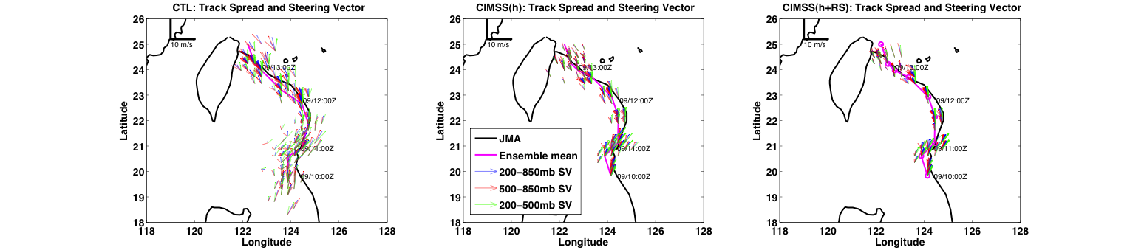
Deep-layer steering flow is the best estimate of the motion vector, especially in the CIMSS(h+RS).

Slide 41
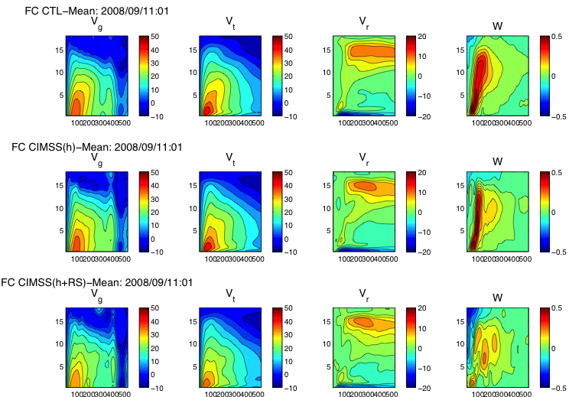
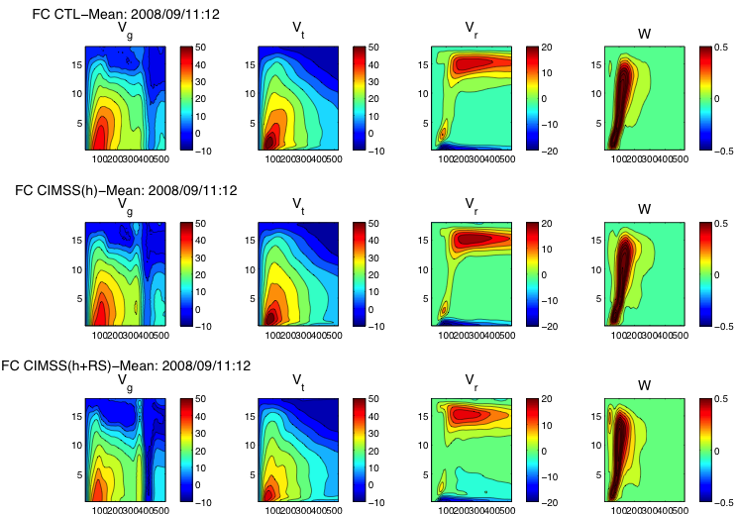
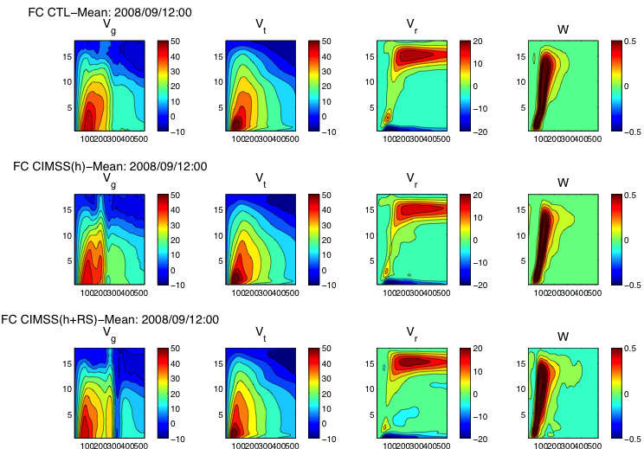
FC11
01H
12H
24H
CTL
CTL
CTL
CIMSS(h)
CIMSS(h)
CIMSS(h)
CIMSS(h+RS)
CIMSS(h+RS)
CIMSS(h+RS)
Notes:
Height-radius plots of azimuthal-mean tangential wind, radial wind and vertical wind

Slide 42
96-h WRF/EnKF Forecasts
27 km domain with 9 km nested domain using 20 members.
Same BC, physics and dynamics.
WRF-EnKF parallel forecasts | Initial time | Initial conditions
FC09 | 00 UTC 09 Sep, 2008 | CTL and CIMSS(h)
FC10 | 00 UTC 10 Sep, 2008 | CTL and CIMSS(h)
FC11 | 00 UTC 11 Sep, 2008 | CTL, CIMSS(h) and CIMSS(h+RS)

Slide 43
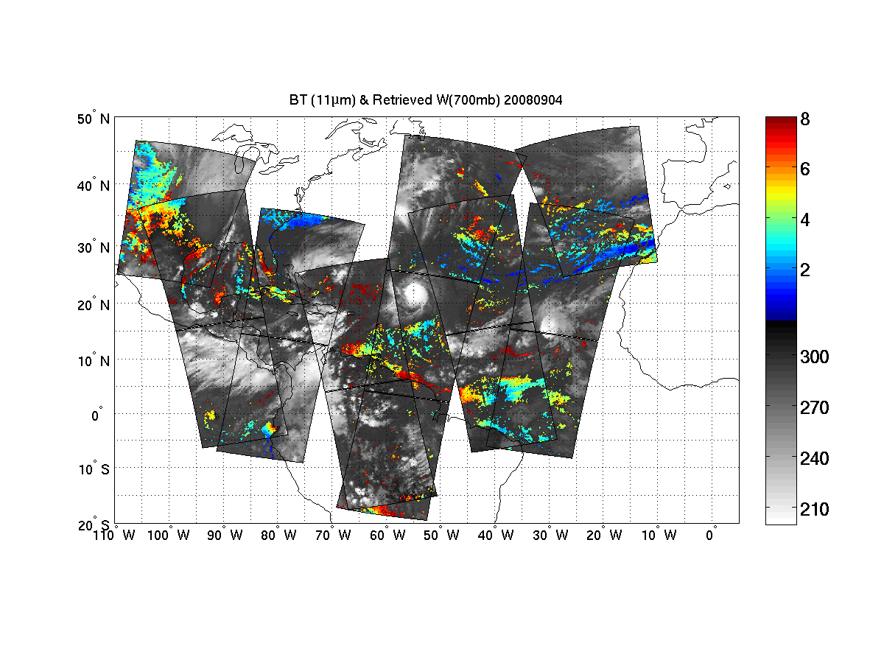
Datasets prepared: CIMSS/UWisc.
Single field of view AIRS temperature/moisture profiles
Recently adapted for IASI clear sky soundings
Under development: algorithms for cloudy sky soundings

Slide 44
Assimilation of AIRS T/Q Soundings (from CIMSS) and TPW
Control (CTL): Radiosondes, cloud winds (AMVs from JMA) extracted from NCEP/GFS dataset, aircraft data, station and ship surface pressure data, JTWC advisory TC positions, 6-hourly analysis cycle.
AIRS T: Add only CIMSS single view (15km) T profiles.
AIRS Q: Add only CIMSS single view (15km) Q profiles.
AIRS T/Q: Add both CIMSS T and Q profiles.
TPW: Add only CIMSS processed AMSR-E microwave TPW data.
AIRS T data reduces the initial track error.
Assimilation of TPW greatly improve the intensity and track analyses.

Slide 45
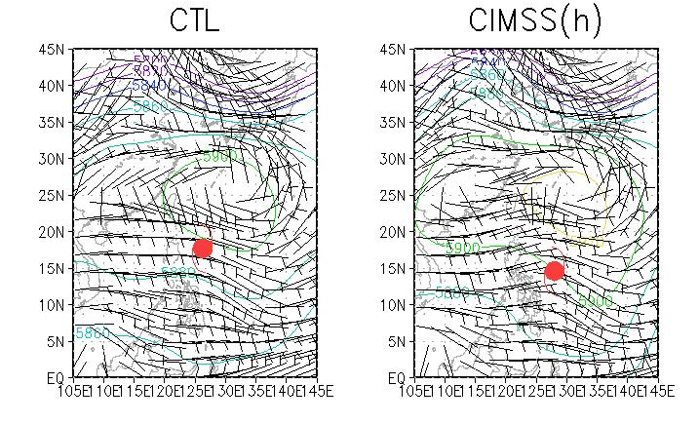
Analysis track and intensity
Minimum Sea-level Pressure
500mb Geopotential Height / wind
Notes:
The upper 3 panels are analyses track and spread against JMA best track in solid black line.
Colored dots are TC locations as a function of time from magenta to red.
A general narrower spread can be observed along the analysis time.
In the early state, CTL had an erroneously straight westward motion while CIMSS(h)

Slide 46
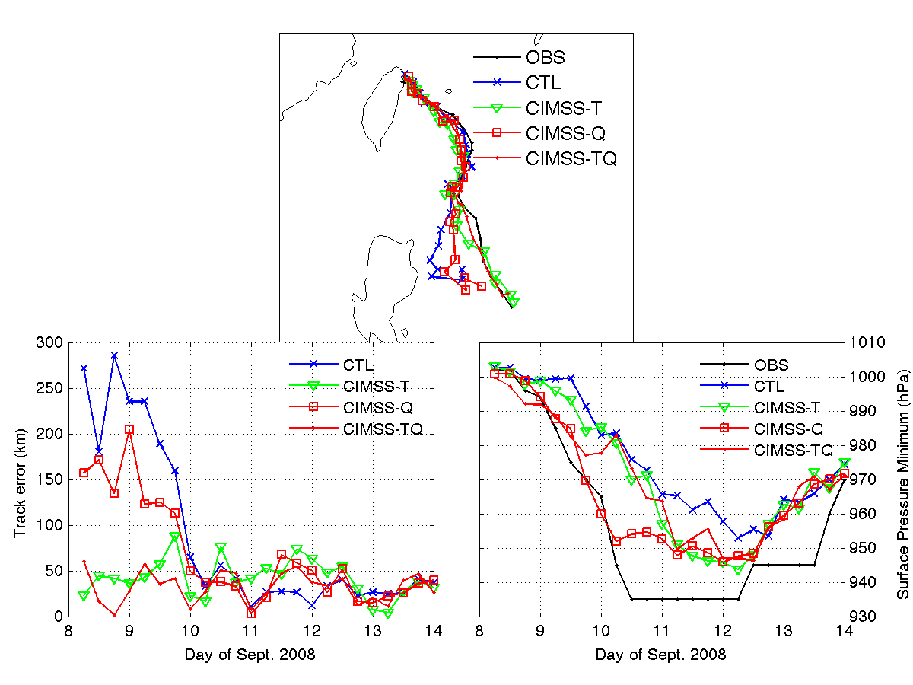
Sinlaku track/intensity analysis: AIRS soundings (WRF/DART)
CTL run: assimilate radiosonde, satellite cloud winds, QuikSCAT winds, aircraft data, COSMIC GPS refractivity, ship, and land surface data.
OBS
CTL
AIRS-T
AIRS-Q
AIRS-TQ
Rapid intensification from 9 to 10 September 2008 captured with water vapor soundings assimilated
CTL
AIRS-T
AIRS-Q
AIRS-TQ
OBS
CTL
AIRS-T
AIRS-Q
AIRS-TQ
Temperatures reduce track errors during rapid intensification

